Slide 1
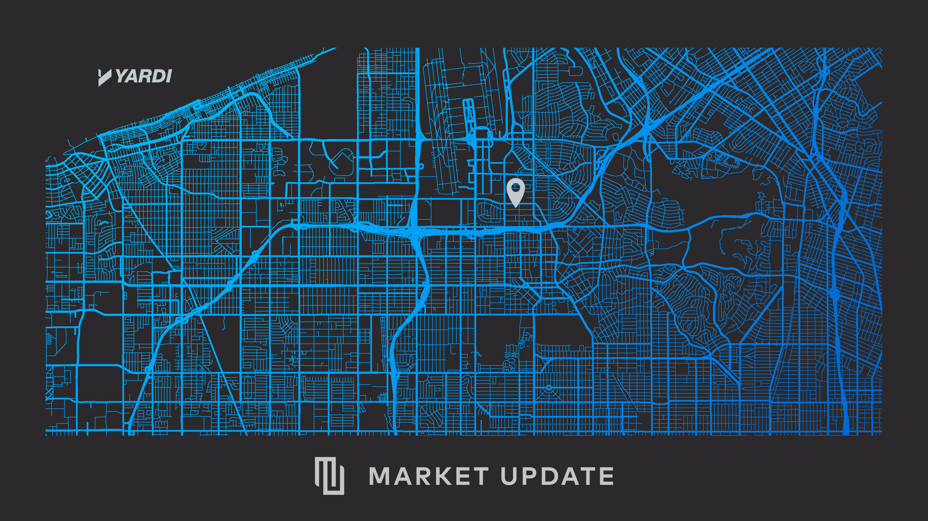
Notes:
We have an aggressive agenda today with a lot to cover. My goal today is to have you walk away with
1.First, a Broad Update today on the general economy and the overall state of the real estate market
2.Secondly, we will focus on the Commercial Segments and will spotlight a city here in the local market to get a sense of where things stand.
3.Lastly I would like to briefly cover some emerging technologies we think will affect us all as they mature

Slide 2

MULTIFAMILY MARKET UPDATE
DHARMENDRA SAWH
INDUSTRY PRINCIPAL
APRIL 9, 2019
Notes:
Good morning everyone and welcome to our Market Update session today. I would like to start by thanking you for spending part of your day with us to discuss the state of the real estate market.
My name is Dhar Sawh and I have been with Yardi for about 8 years now.

Slide 3

AGENDA
Macroeconomic Outlook
Multifamily Fundamentals
Detroit Spotlight
Affordability
New Technologies Emerging
Notes:
We have an aggressive agenda today with a lot to cover. My goal today is to have you walk away with:
1. First, a broad update today on the general economy and the overall state of the real estate market.
2. Secondly, we will focus on the commercial segments and will spotlight a city here in the local market to get a sense of where things stand.
3. Lastly, I would like to briefly cover some emerging technologies we think will affect us all as they mature.

Slide 4
KEY TAKEAWAYS
ECONOMY
The economy is in decent shape. GDP growth is decelerating but still north of 2%. Slow growth in China and Europe along with a drop in oil prices have brought inflation back to 2%. The yield curve almost inverted, but Fed easing has pulled us back from the brink. The labor market is extremely tight, and wages continue to rise.
MULTIFAMILY MARKET
Demand continues to be strong with jobs and population shifting to lower cost cities and tech hubs. New supply deliveries completed at just under 300,000 units in 2018, and with the constraints of financial and labor costs, 2019 and 2020 deliveries are expected to be flat.
RENT GROWTH
Rent has bounced back from dips in late 2017 to early 2018 and remain around the 3% growth rate nationally with significant variations by city, while occupancy remains stable around 95%.
VALUATIONS & TRANSACTIONS
Valuations continue to rise at a steady pace with compressed cap rates, and this has shifted the focus to tech hub and tertiary markets to look for potential value add opportunities. Transaction volume in 2018 came in 0.7% lower than 2017, however with 10.8% higher total dollars at $111 billion. The markets where the transactions occurred reflect the shift, as 9% of the transactions occurred in primary markets and 49% in tech hub and 42% in tertiary markets.
DEMOGRAPHIC SHIFTS
As companies and people look for lower cost alternate cities, they drive a shift of both jobs and population to tech hub cities previously not considered. When this happens, real estate will follow. We see this shift happening from urban cores to urbanized suburbs or intellectual capital nodes. The tax reform passed in 2017 will likely accelerate this trend but provide opportunities along the way.
Source: Yardi® Matrix

Slide 5
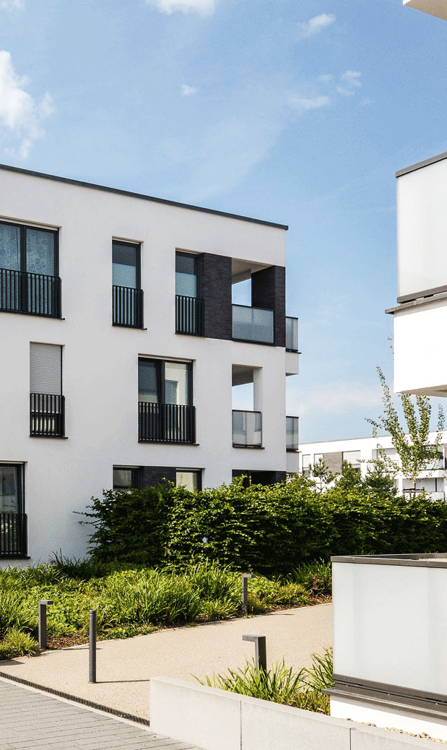
GDP and employment will continue to grow, but at a slower, steadier pace.
Supply/demand conditions continue to favor mild rate growth, with higher rates in the tech hub and tertiary markets.
Recent demand has been stronger than anticipated.
Supply will be the key variable in the next 2-5 years.
Technological advances are coming that will impact how we invest in and manage commercial real estate.
For new investments, it’s a sharpshooter’s game to find the right deal at the right price.
On the operational side, its about finding revenue and cost trimming opportunities to grow your NOI from your existing assets.
2019 OUTLOOK
Source: Yardi® Matrix
Notes:
So, to begin with, what are we seeing?
The U.S. economy is good and looks like it will continue to grow at a slower but steady pace.
GDP and employment are up and maintaining a good pace (most recent jobs numbers were above expectations) and we are seeing sustained wage growth which is good for the office sector.
Along with the demographic shifts, the per sq. ft. per employee contraction and coworking sector will have an impact on how much and in what form office is impacted.

Slide 6
MACROECONOMIC OUTLOOK

Slide 7
U.S. Economic Growth is Good but Moderating
Source: Yardi® Matrix; Moody’s Analytics; Bureau of Labor Statistics (BLS); S&P Dow Jones Indices LLC; CoreLogic, Inc; Federal Housing Agency (FHFA); Freddie Mac; Fannie Mae; U.S. Bureau of Economic Analysis (BEA); U.S. Board of Governors of the Federal Reserve System (FRB); Investing.com; Federal Reserve Bank of Atlanta
Notes:
GDP – 1/30 update for Q4 data
CCI – 1/29 for Jan data
As I mentioned before, GDP is still above 2% and consumer confidence is still rising even with a slower fourth quarter in 2018.

Slide 8
Tight Labor Market, Pulling People Off the Sidelines
  It is difficult to find labor at the right price, with the right skills, in the right city
Preliminary Jan. 2019: 311,000
Preliminary Feb. 2019: 20,000
Currently less than one unemployed person for every one job opening
*Through December 2018
Source: Yardi® Matrix; Moody’s Analytics; Bureau of Labor Statistics (BLS); The Conference Board
Notes:
Continuing on the labor market, we continue to see good job growth with there being less than one resource per job opening. In January’s jobs report, the number of jobs created exceeded expectation.
This makes it hard to find the right skills for the jobs and so companies are starting to pull people off of the sidelines back into the workforce.
Now you have to go find the resources you need for the job, this is a workforce market…

Slide 9
Wage Growth Finally Emerging
  Feb: 3.4%
  Feb: 3.8%
Source: Yardi® Matrix; Moody’s Analytics; Bureau of Labor Statistics (BLS); Current Population Survey (CPS);
Notes:
https://www.frbsf.org/our-district/about/sf-fed-blog/wage-growth-good-news/
This creates the situation where the demand for workers outweighs the resources available to work putting upward pressure on wages.
As an interesting note, the actual wage growth is masked by the workforce substitution that is happening with older, higher paid workers retiring and being replaced by younger workers at the lower end of the salary range.

Slide 10
Inflation Rising, But Unlikely to Break Out >2.5%
*YOY 6-month moving avgs. CPI Less Health Care, Education and Rent
is an estimate using BLS document “Math calculations to better utilize CPI data”
Source: Yardi® Matrix; Moody’s Analytics; Bureau of Labor Statistics (BLS)
Notes:
One of the major drivers to the Feds policy over interest rates is inflation. As I mentioned at the top, the recent slowing both globally and here at home has tempered the rate of inflation and has influenced the Feds outlook to a more conservative approach from what their view was in Q3 of 2018.

Slide 11
U.S. and International Financial Market
A breakout >3% is significant
+0.3% YOY
-23 bps
-23 bps
Source: Yardi® Matrix; Moody’s Analytics; Investing.com

Slide 12
U.S. Federal Policy Mix is Mildly Pro-Growth –
Shifting Away From Consumers Towards Producers
PRO-GROWTH
PRO-GROWTH BUT SLOW
ANTI-GROWTH
Tax Reform
Regulatory Relief
Executive Orders
  Energy
  Finance
  Labor Costs
Infrastructure
Education Reform
  German Model
Healthcare Reform
Immigration Control
Trade Renegotiation
  President Trump announced U.S. will impose tariffs on steel and aluminum imports
GENERALLY
POSITIVE
PROGRESS
PROGRESS IN TONE,
BUT NOT YET
SUBSTANTIVE
RECENT TARIFF MOVE
A POTENTIAL DRAG
ON GROWTH
Source: Yardi® Matrix
Notes:
There are some other areas that will affect the cycle and that is mainly around policy. The current administration’s policies are a mix on growth.
The clear pro-growth components are the tax cuts and de-regulation actions whereas the policies that will slow growth (at least in the short term) are immigration and trade.

Slide 13
SUMMARY
1
2
3
The U.S. economy is strong
Employment and wage growth are good
How much slack is left?
Productivity
Job Growth
4
5
Inflation rising but not a lot, so the 10-yr rate is the binding constraint on the yield curve
Fiscal policy is mildly pro-growth
Capital still needs to be deployed
Source: Yardi® Matrix

Slide 14
MULTIFAMILY FUNDAMENTALS

Slide 15
Multifamily Supply Has Leveled Out;
Construction Delays and Financing are a Factor
Source: Yardi® Matrix
Notes:
On the office side, new supply was expected to peak in 2018 and looking at 2019, delivers are expected to come in around?????

Slide 16
Multifamily Construction Catching
Up to New Household Formation
  Cumulative deficit in supply from:
  2000-2018: 164,100 units
  2010-2018: 2,498,300 units
Source: Yardi® Matrix; Moody’s Analytics; National Association of Realtors (NAR); U.S. Census Bureau (BOC)

Slide 17
Multifamily Rent Growth Has Rebounded
While Occupancy Drops Off
Source: Yardi® Matrix
Notes:
However, overall sales volumes have been dropping indicating pressure from other forces.

Slide 18
Major Market Multifamily Rent and Occupancy Growth
*Feb. 2018 – Feb. 2019
Source: Yardi® Matrix
Notes:
However, overall sales volumes have been dropping indicating pressure from other forces.

Slide 19
Ranked Multifamily Rent and Occupancy Growth
*Feb. 2018 – Feb. 2019
Source: Yardi® Matrix
Notes:
However, overall sales volumes have been dropping indicating pressure from other forces.

Slide 20
National Multifamily Values Keep Rising
Source: Yardi®Matrix
Notes:
In commercial office space, gateway markets have performed well, however,

Slide 21
Multifamily Transactions Have Been Fairly Stable Over
the Past Five Years, but With Higher Dollar Amounts
Source: Yardi®Matrix
Notes:
If you look at tech hub markets from 2008 to now, office space in tech hub markets have outperformed primary markets. This ties in with the trends we are seeing in emergence and development of tech hubs mentioned earlier.

Slide 22
Multifamily Sales Are Concentrated
in Tech Hub and Tertiary Markets
Source: Yardi® Matrix
Notes:
However, overall sales volumes have been dropping indicating pressure from other forces.

Slide 23
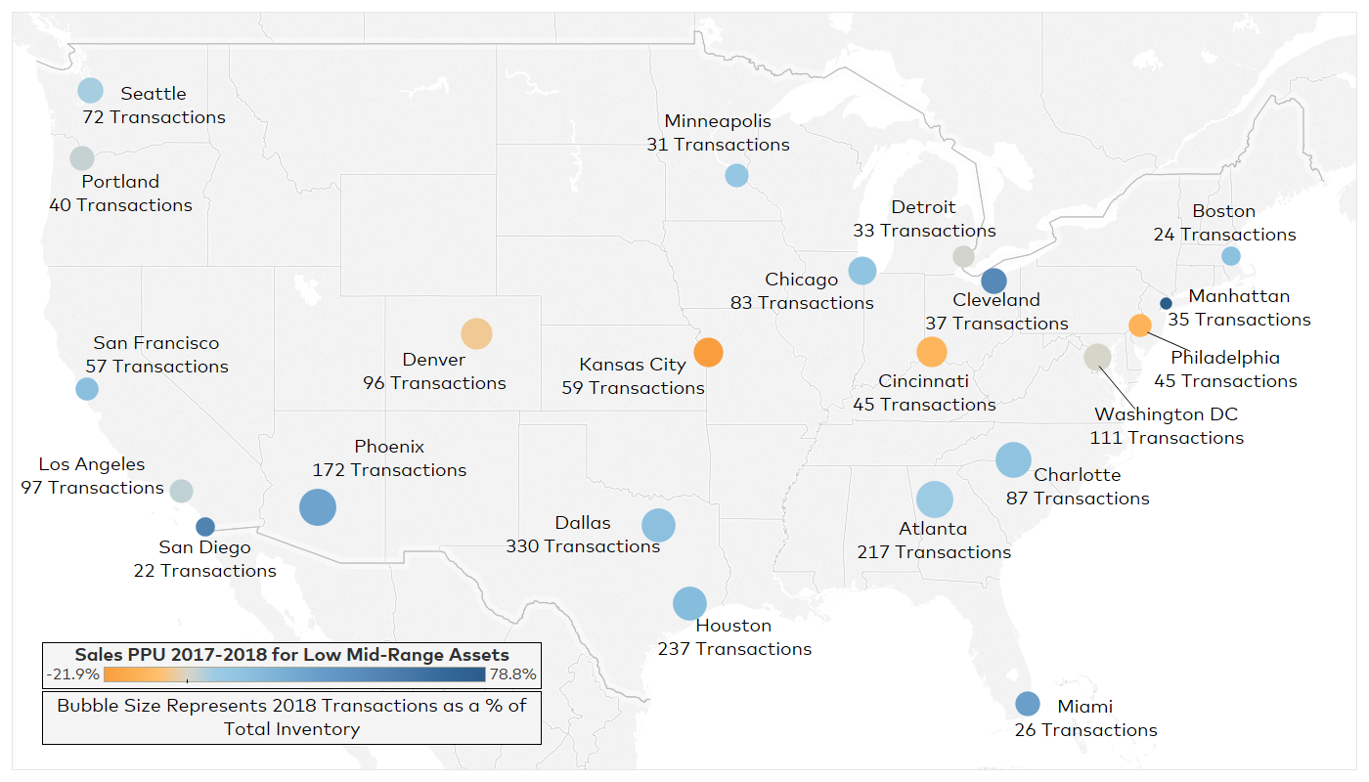
Multifamily Transactions in 2018
Source: Yardi® Matrix; Tableau

Slide 24
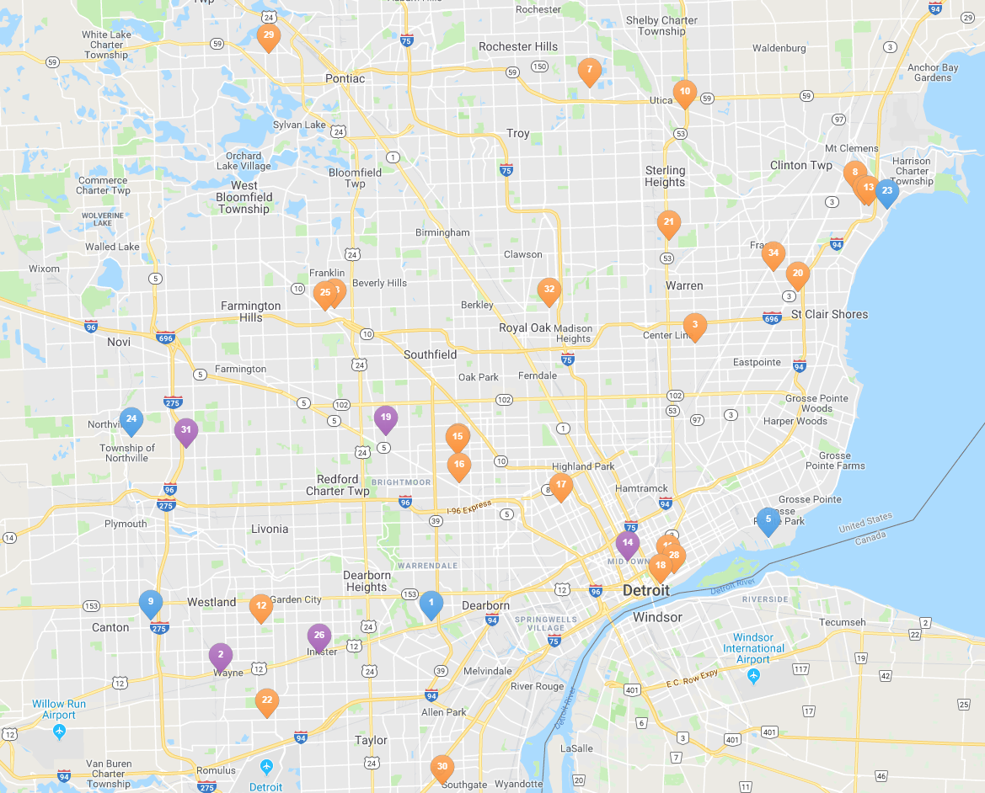
Detroit’s Multifamily Transaction Composition in 2018
2018 Transactions
 | # | % of Stock
Properties Sold | 33 | 3.1%
Units Sold | 6,096 | 2.9%
2018 Sales Prices
Avg. Sales Price per Unit | $71,727
Avg. Sales Price per Unit for Low Mid-Range Assets | $139,598
1-Year Sales Price Growth for Low Mid-Range Assets | 0.95%
5-Year Sales Price Growth for Low Mid-Range Assets | 129.4%
  Property Asset Class:
Source: Yardi® Matrix

Slide 25
Population Growth is in Non-Gateway Markets
Primarily tech hub and tertiary markets seeing stable or rising population growth since 2015
Market | 2015 Pop. Growth | 2016 Pop. Growth | 2017 Pop. Growth | Overall Trend
Austin | 3.0% | 2.9% | 2.4% | Decelerating
Las Vegas | 2.2% | 2.2% | 2.2% | Stable
Raleigh | 2.5% | 2.5% | 2.1% | Decelerating
Orlando | 2.7% | 2.5% | 2.1% | Decelerating
Dallas | 2.2% | 2.2% | 2.0% | Decelerating
Charlotte | 2.1% | 2.1% | 1.9% | Decelerating
Columbus | 1.2% | 1.3% | 1.9% | Accelerating
Phoenix | 2.0% | 2.0% | 1.8% | Decelerating
Tampa | 2.1% | 2.1% | 1.5% | Decelerating
Nashville | 2.1% | 2.1% | 1.5% | Decelerating
Atlanta | 1.7% | 1.6% | 1.5% | Decelerating
Sacramento | 1.2% | 1.3% | 1.3% | Stable
Denver | 1.9% | 1.4% | 1.3% | Decelerating
Indianapolis | 0.9% | 1.0% | 1.3% | Accelerating
Seattle | 1.8% | 1.9% | 1.2% | Decelerating
Market | 2015 Pop. Growth | 2016 Pop. Growth | 2017 Pop. Growth | Overall Trend
Minneapolis | 0.8% | 1.2% | 1.2% | Stable
Washington DC | 1.0% | 1.0% | 1.2% | Accelerating
Salt Lake City | 1.5% | 1.7% | 1.2% | Decelerating
Houston | 2.4% | 1.7% | 1.1% | Decelerating
Portland | 1.8% | 1.6% | 0.8% | Decelerating
San Francisco | 1.1% | 0.6% | 0.7% | Accelerating
Boston | 0.7% | 0.7% | 0.6% | Decelerating
San Diego | 0.9% | 0.8% | 0.5% | Decelerating
Philadelphia | 0.2% | 0.2% | 0.4% | Accelerating
San Jose | 1.0% | 0.5% | 0.4% | Decelerating
New York | 0.5% | 0.3% | 0.2% | Decelerating
Detroit | 0.0% | 0.2% | 0.1% | Decelerating
Los Angeles | 0.4% | 0.2% | 0.1% | Decelerating
Miami | 1.2% | 1.0% | 0.1% | Decelerating
Chicago | -0.1% | -0.1% | -0.1% | Steady/Negative
Source: Yardi® Matrix; Moody’s Analytics; U.S. Census Bureau (BOC)
Notes:
Consequently, there is a corresponding growth in office in those tech hubs that the migration is happening in.
This is a list of markets ranked by change in asking rents.

Slide 26
Immigration is Key to Gateway Population Growth
Tech Hub Markets:
High Migration, Modest Immigration
Gateway Markets:
High Immigration, Low/Negative Migration
*July 2016 – July 2017
Source: Yardi® Matrix; U.S. Census Bureau (BOC)
Notes:
Consequently, there is a corresponding growth in office in those tech hubs that the migration is happening in.
This is a list of markets ranked by change in asking rents.

Slide 27
Tech Hub and Tertiary Markets Will Have the Most
Multifamily Rent Growth Over the Next Couple Years
Market | YoY February 2018-2019 | 2019 (F) | 2020 (F) | 2021 (F)
Reno | 7.5% | 7.9% | 7.0% | 5.0%
Macon | 3.2% | 7.1% | 6.6% | 6.2%
Sacramento | 5.1% | 6.5% | 6.2% | 4.9%
Tacoma | 5.9% | 5.8% | 5.3% | 4.9%
Fort Wayne | 2.5% | 5.5% | 5.2% | 4.9%
Central Valley | 5.6% | 5.2% | 4.5% | 4.0%
Spokane | 4.7% | 5.1% | 3.9% | 3.7%
Eastern LA County | 4.4% | 4.9% | 4.9% | 4.5%
Eugene | 4.7% | 4.7% | 4.5% | 4.9%
Salt Lake City | 3.8% | 4.6% | 4.4% | 3.8%
Market | YoY February 2018-2019 | 2019 (F) | 2020 (F) | 2021 (F)
Inland Empire | 5.0% | 4.5% | 4.3% | 3.9%
Fort Worth | 3.9% | 4.5% | 3.4% | 3.2%
Dallas - Suburban | 3.5% | 4.5% | 4.3% | 3.3%
Central Coast | 4.7% | 4.5% | 4.1% | 4.1%
Boise | 7.3% | 4.3% | 3.3% | 3.0%
Orlando | 4.4% | 4.0% | 4.0% | 3.9%
Las Vegas | 7.9% | 4.0% | 3.5% | 2.8%
Colorado Springs | 3.8% | 4.0% | 3.8% | 3.5%
Dallas - North | 2.3% | 4.0% | 3.6% | 3.5%
Seattle | 2.5% | 4.0% | 3.9% | 3.8%
*Full market forecast on 133 markets and submarkets available for clients
*Data ranked by 2019 forecast values
Source: Yardi® Matrix

Slide 28
Tertiary Markets and a Couple Gateway Markets Will Have
the Least Multifamily Rent Growth Over the Next Couple Years
Market | YoY February 2018-2019 | 2019 (F) | 2020 (F) | 2021 (F)
Bridgeport - New Haven | 1.9% | 1.7% | 1.4% | 1.5%
South Bend | 2.7% | 1.7% | 1.6% | 1.6%
Mobile | 5.0% | 1.6% | 2.0% | 2.2%
Washington DC | 2.8% | 1.6% | 1.5% | 1.7%
Fort Lauderdale | 2.1% | 1.6% | 1.7% | 1.9%
Baton Rouge | -0.2% | 1.5% | 1.9% | 2.3%
Omaha | 3.5% | 1.5% | 1.5% | 2.2%
Toledo | 2.9% | 1.4% | 1.4% | 1.4%
Jackson | 2.5% | 1.4% | 1.1% | 1.3%
Baltimore | 2.5% | 1.3% | 1.4% | 1.3%
Market | YoY February 2018-2019 | 2019 (F) | 2020 (F) | 2021 (F)
Tulsa | 1.7% | 1.3% | 1.4% | 1.0%
Oklahoma City | 2.3% | 1.3% | 1.1% | 1.5%
Central East Texas | 0.4% | 1.2% | 1.5% | 1.0%
Columbus GA | 3.5% | 1.2% | 1.3% | 1.0%
McAllen | 1.2% | 1.0% | 1.2% | 1.8%
Northern Virginia | 2.8% | 1.0% | 1.6% | 1.8%
Manhattan | 0.8% | 0.7% | 1.1% | 1.4%
Amarillo | 1.1% | 0.6% | 0.4% | 0.5%
El Paso | 4.1% | 0.6% | 0.5% | 0.8%
Corpus Christi | 1.1% | 0.5% | 0.4% | 0.6%
*Full market forecast on 133 markets and submarkets available for clients
*Data ranked by 2019 forecast values
Source: Yardi® Matrix

Slide 29
SUMMARY
1
2
Demand is strong, but there are constraints on supply due to construction delays and financing
Rent growth continues to hum along, with lower asset classes outperforming
3
4
Sales prices continue to rise, and most transactions occur in tech hub and tertiary markets, where population is also growing
Rent growth will continue to grow the most in tech hub and tertiary markets with the support of strong population and employment fundamentals
Source: Yardi® Matrix

Slide 30
CITY SPOTLIGHT

Slide 31
What Helps a City Reach Its Critical Point to Succeed?
    ALL EXISTING TECH MARKETS HAVE THESE CHARACTERISTICS TO SOME DEGREE
PUBLIC & PRIVATE PARTNERSHIPS
FRIENDLY BUSINESS ENVIRONMENT
COMMUNITY & AMENITIES THAT RETAIN & DRAW IN TALENT
EDUCATED WORKFORCE
*A workbook of major U.S. markets is available to clients upon request
Source: Yardi® Matrix

Slide 32
What’s Going on in Detroit?
PUBLIC & PRIVATE PARTNERSHIPS
The QLINE, Detroit’s new urban rail streetcar linking downtown to the city’s cultural center in Midtown and beyond, was funded by Dan Gilbert, city government, philanthropic and business contributions
Larson Realty Group, Goldman Sachs, Capital Impact Partners, Michigan Strategic Fund, and the city of Detroit, among others, funding “The Corner”, $30 million mixed-use project
FRIENDLY BUSINESS ENVIRONMENT
State Rank #31
Empowerment Zone (EZ) tax incentives
  Credit against taxes up to $3,000/year for existing employees & new hires that live and work in the EZ
  Credit up to $2,400 for new hires between the ages of 18 and 24 who live in an EZ
Ford Motor Co. was granted a 30-year, $208.8 million tax abatement for their planned campus in Detroit’s Corktown
COMMUNITY & AMENITIES THAT
RETAIN & DRAW IN TALENT
The District, a $1 billion project including a hockey arena and massive commercial, residential and entertainment space spanning a 50-block area
  Bars, restaurants, retail, offices, housing and the new home for the Mike Ilitch School of Business at Wayne State University, which is expected to bring 3,500 graduate/undergraduate students to the area
EDUCATED WORKFORCE
14.2% of adults in the city of Detroit have a Bachelor’s degree or higher
University | Approx. Enrollment 2018
Michigan State University | 50,351
University of Michigan | 43,499
Wayne State University | 27,053
University of Detroit Mercy | 5,111
Source: Yardi® Matrix; ro.umich.edu; forbes.com; msu.edu; Urban Land, Spring 2018; wayne.edu; udmercy.edu; census.gov; detroitmi.gov; autonews.com

Slide 33
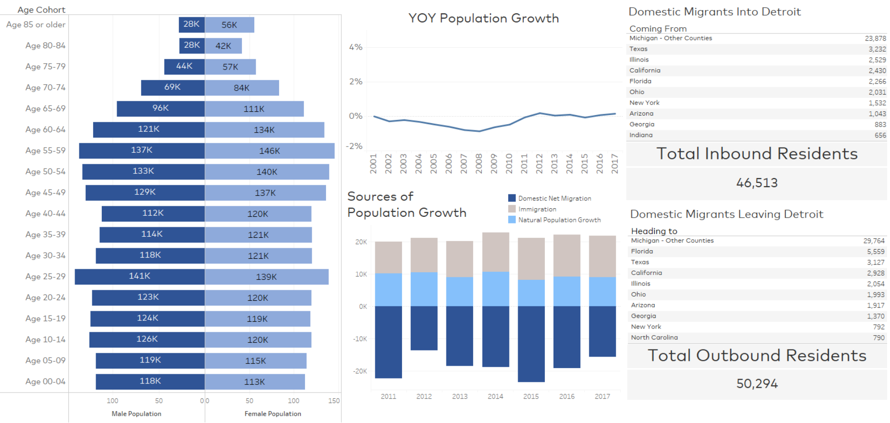
Detroit Demographics Overview
*County-level data; Migration data as of 2016
Source: Yardi® Matrix

Slide 34
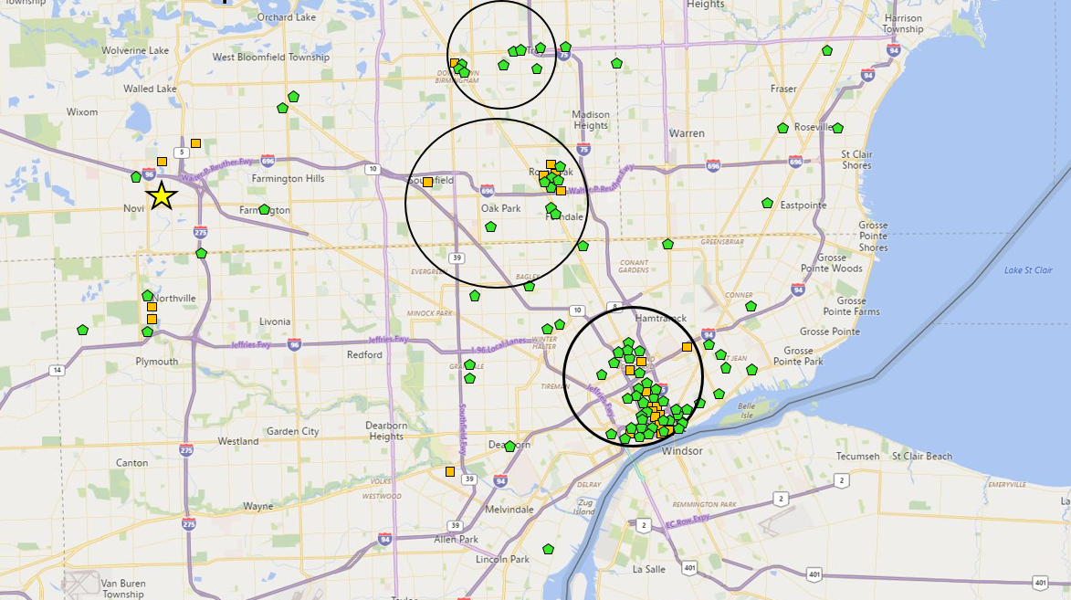
Detroit’s Intellectual Capital Nodes
Troy
Multifamily
15% Rent Growth
1% Supply Growth
-1.0% Occupancy Change
Office
14,098,848 sq. ft.
12.4% of total inventory
Novi
Southfield/Oak Park
Multifamily
13% Rent Growth
1% Supply Growth
0.1% Occupancy Change
Office
11,170,866 sq. ft.
9.9% of total inventory
Detroit Metro
Multifamily
12% Rent Growth
2% Supply Growth
-0.4% Occupancy Change
Office
113,375,448 sq. ft.
Downtown Detroit
Multifamily
19% Rent Growth
10% Supply Growth
-1.5% Occupancy Change
Office
24,424,231 sq. ft.
21.5% of total inventory
Office Development
Multifamily Development
Emerging Node
*Multifamily rent growth based on Feb. 2016 through Feb. 2019
*Change in multifamily occupancy based on Feb. 2018 through Feb. 2019
Source: Yardi® Matrix

Slide 35
Detroit: High Rents but Falling Occupancy
Detroit Asset Class | Rent CAGR 2015-2019 | Rent CAGR 2018-2019
Lifestyle | 1.2% | 0.8%
Renter-by-Necessity | 1.5% | 1.6%
Overall | 1.4% | 1.6%
*Rent and occupancy data June 2015 – Feb. 2019
Source: Yardi® Matrix
Notes:
However, overall sales volumes have been dropping indicating pressure from other forces.

Slide 36
Top 5 Detroit Submarket Rent and Occupancy Forecasts
 | 2018 |  |  | 2019 (FORECAST) |  |  | 2020 (FORECAST)
Submarket | Rent Growth | Avg. Rent | Occupancy | Rent Growth | Avg. Rent | Occupancy | Rent Growth | Avg. Rent | Occupancy
Detroit - East | 9.8% | $1,032 | 92.3% | 3.6% | $1,069 | 91.9% | 3.3% | $1,105 | 92.4%
Troy | 2.9% | $1,241 | 95.5% | 3.4% | $1,282 | 95.0% | 3.1% | $1,322 | 95.6%
Auburn Hills | -0.1% | $1,106 | 96.3% | 3.3% | $1,142 | 96.0% | 3.1% | $1,177 | 96.4%
Bloomfield Hills\Birmingham | 3.0% | $1,346 | 96.8% | 3.1% | $1,388 | 96.5% | 2.8% | $1,427 | 96.9%
Livonia\Redford | 4.5% | $975 | 96.4% | 2.9% | $1,003 | 96.1% | 2.7% | $1,030 | 96.5%
Detroit | 3.2% | $981 | 96.2% | 2.7% | $1,001 | 96.1% | 2.5% | $1,026 | 96.5%
*Full market forecast on 133 markets and submarkets available for clients
*Data ranked by 2019 forecast rent growth
Source: Yardi® Matrix

Slide 37
Detroit Sales Prices
  10-Year Growth: 118.6%
  10-Year CAGR: 8.1%
  2008 Avg.
  Price per Unit = $34,402
  2018 Avg.
  Price per Unit = $75,204
Source: Yardi® Matrix

Slide 38
Completions Surged in 2017 After Years of Limited New Supply
Source: Yardi® Matrix

Slide 39
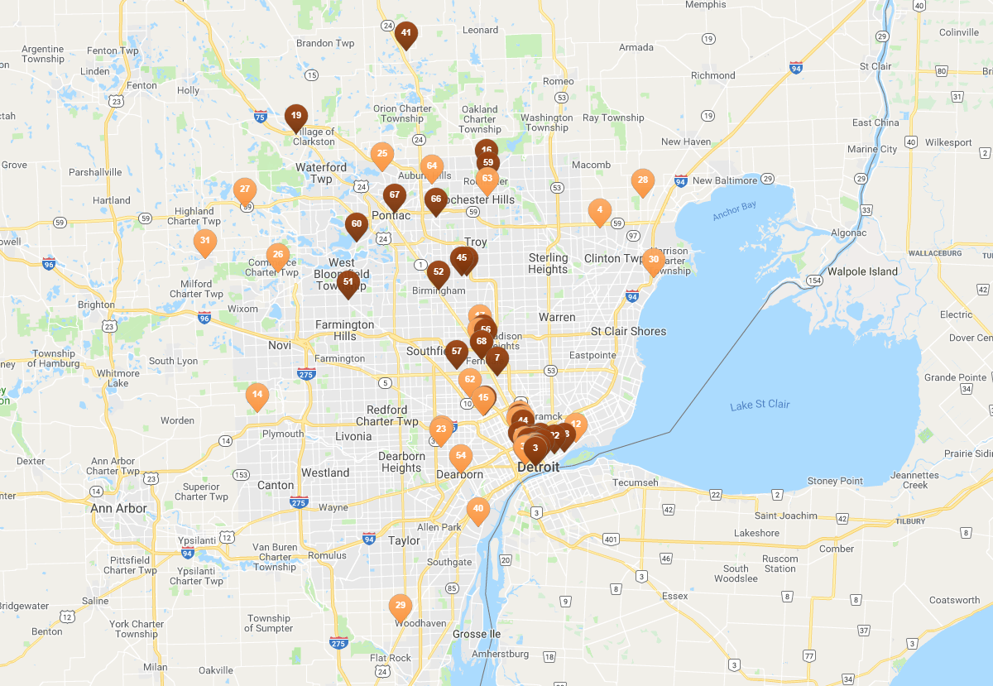

Detroit’s Development Pipeline
*As of March 2019
Source: Yardi® Matrix

Slide 40
Top 5 Submarkets With Units Under Construction
Submarket | Units Under Construction | % of Existing Stock
Detroit - South | 314 | 34.1%
Holly\White Lake | 109 | 32.9%
Detroit - New Center | 556 | 15.9%
Detroit - Downtown | 1,053 | 10.6%
Lincoln Park\Melvindale | 200 | 10.3%
Source: Yardi® Matrix

Slide 41
SUMMARY
1
2
Domestic migration out of Detroit is an unfavorable factor for multifamily, and the city continues to rely on natural immigration to back-fill residents
Rents have been rising modestly in Detroit, however occupancy has been falling since Fall 2018
3
4
Sales prices per unit have increased 119% over the past ten years, but prices fell from 2017 to 2018
Completions have been stagnant over the past ten years, with the exception of 2017 when a surge in new supply was added; there are still a number of projects in the pipeline, specifically around the urban core
Source: Yardi® Matrix

Slide 42
AFFORDABILITY

Slide 43
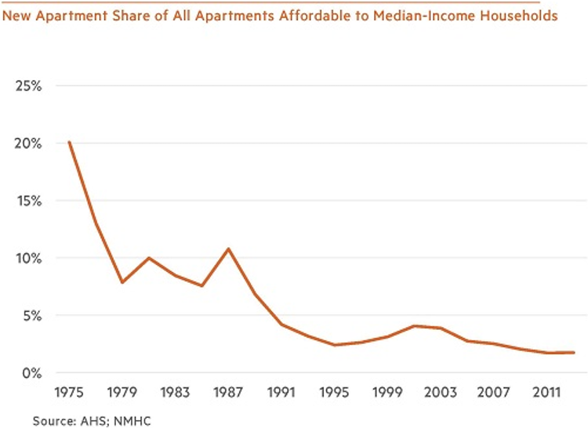
There are Fewer New Apartments
Affordable to Median-Income Residents
  The share of all apartments that are affordable to median-income households and were no more than five years old ranged from about 10-20 percent in most of the 1970s and 1980s
  It fell to an average of 3.1 percent in the 1990s and 2000s and has slipped even further to only 1.8 percent in the current decade (data through 2013)
*Affordable defined as rent no more than 30% of income
Source: Yardi® Matrix; National Multifamily Housing Council (NMHC), “Did We Ever Build Apartments for the Middle Market?”; American Housing Survey (AHS)

Slide 44
Median Asking Rent Rising Faster Than Inflation
  Between 1970-2012, the periods in which the median rent grew more slowly than overall inflation were balanced by periods in which it grew faster
  Since then, the median asking rent has risen much more rapidly than inflation
Source: Yardi® Matrix; National Multifamily Housing Council (NMHC), “Did We Ever Build Apartments for the Middle Market?”;
U.S. Census Bureau (BOC); U.S. Bureau of Labor Statistics (BLS)

Slide 45

Public and Private Policy Responses to Affordability Issue
COMMAND/MANDATE-ORIENTED
Statewide Rent Control in Oregon
Repeal of Costa-Hawkins (CA)
Inclusionary Zoning
MARKET-ORIENTED
Coliving – Reduces Space Needs
Airbnb – Monetizes Unused Time
Streamlined Zoning
Freddie Mac Loan Payments
HUD Policy Changes
Modular/Standardized Construction
Opportunity Zones
Source: Yardi® Matrix

Slide 46
Differing Public Policy Responses
RESTRICT
SUPPLY
ALLOW SUPPLY TO RESPOND TO DEMAND
San Francisco
Los Angeles
Portland
New York City
Seattle
Dallas
Denver
Houston
Charlotte
Source: Yardi® Matrix

Slide 47
Public Policy Response to Affordability in Oregon
    Oregon is the first state to impose rent control
    Prohibits landlords from raising rents more than 7% per year, in addition to inflation
      Properties that are less than 15 years old are exempt
    Requires landlords to give a reason for evicting renters
      In most cases, termination comes with 90 days’ notice and one month’s rent
    Landlords free to raise rents without a cap if renters leave by their own choice
    Watch for copycat bills in other states, especially CA
Source: Yardi® Matrix; globest.com; npr.org

Slide 48


Private Responses: Niido Powered by Airbnb
  Airbnb-branded apartment buildings encourage homesharing in properties
  Every Niido property has a MasterHost available 24/7 to assist with homesharing needs and comes fully equipped with:
    Keyless entry systems, bike sharing, community rooms, swimming pool, on-site package receiving, 24-hour security, cleaning, linen services, high-speed Wi-Fi, cable TV and event programming
  The first Niido property is Domain in Kissimmee, FL
  DOMAIN IN KISSIMMEE, FL
Source: Yardi® Matrix; Olivia Zaleski, “Surprise, You Live in a Giant Airbnb”, Bloomberg Businessweek; niido.com

Slide 49
Private Responses: Niido Powered by Airbnb
Domain in Kissimmee, FL
  Property Characteristics from Yardi Matrix:
  Completed in 2017
  Currently 65.7% occupied
  324 units total:
    108 one bedroom
    180 two bedroom
    36 three bedroom
  Niido Calculator:
  By sharing a one bedroom Niido Orlando apartment on Airbnb for one day a month, you can cover 7.1% of your rent
  The landlord (Niido) takes a 25% cut from whatever revenues the tenant earns from renting their apartment on Airbnb
 | Average Rent 2018
Orlando | $1,316
Celebration Submarket | $1,507
Subject Property | $1,141-$1,819
  *Calculations are for estimate purposes
  *Reflects 25% Niido service fee. An Airbnb host fee of 3% may also apply
Source: Yardi® Matrix; niido.com

Slide 50
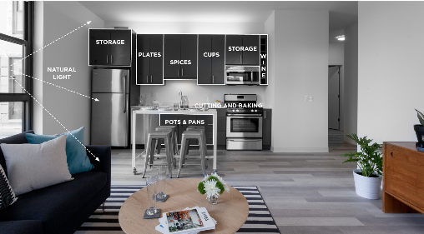
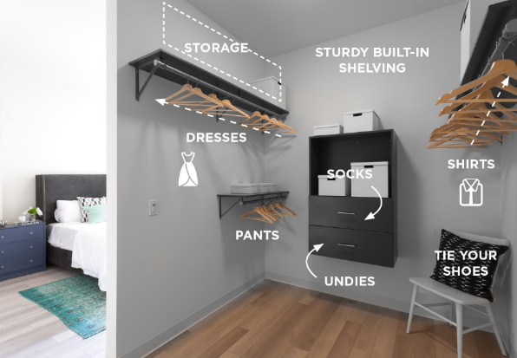

Private Responses: “Rent By Bedroom”
  X SOCIAL COMMUNITIES
    PMG developing 10,000+ unit pipeline of X Social Communities in Chicago, Miami, Ft Lauderdale, Denver, Orlando, Phoenix
    Projects include mix of market rate and "Rent By Bedroom" units
    "Rent By Bedroom"/Coliving = Private bedroom/bathroom in furnished 2-4 bedroom suite with shared kitchen and living area
    Couch and TV, dining table & chairs, cookware, bed and mattress included, along with in-unit laundry
    Kitchen and living areas professionally cleaned every two weeks
    Each member signs their own (typically 12 mo.) lease and is billed separately for their share of utilities
Source: Yardi® Matrix; xmiami.co

Slide 51
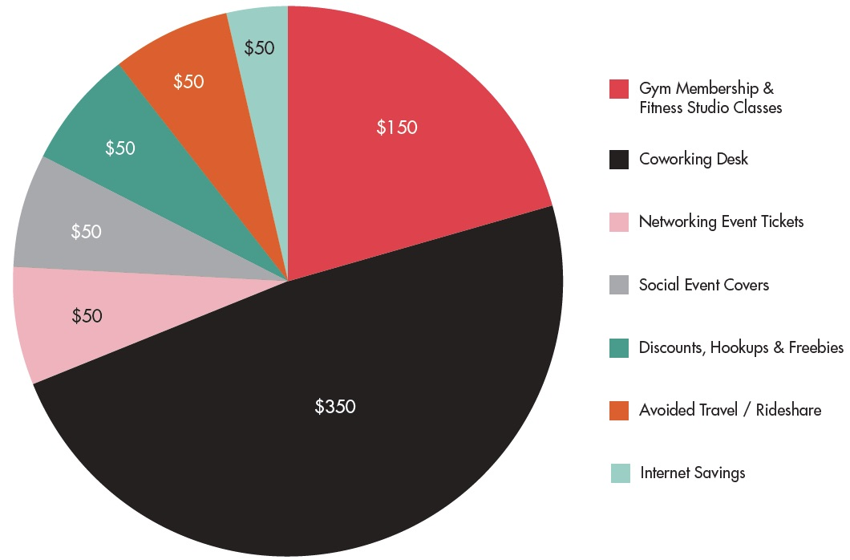
Private Responses: “Rent By Bedroom”
  COMPARATIVE COST ANALYSIS: X SOCIAL COMMUNITIES MONTHLY MEMBER SAVINGS
  Rents starting in the $1,200s (Miami)
    Most attainable way to get into a new construction Class A building in the best location
    Typical entry point is $1,800+
  Rent includes access to gym, coworking, social lounge, pool and community events
  Members save $700+/mo. on services by living at X Miami
Source: Yardi® Matrix; xmiami.co

Slide 52


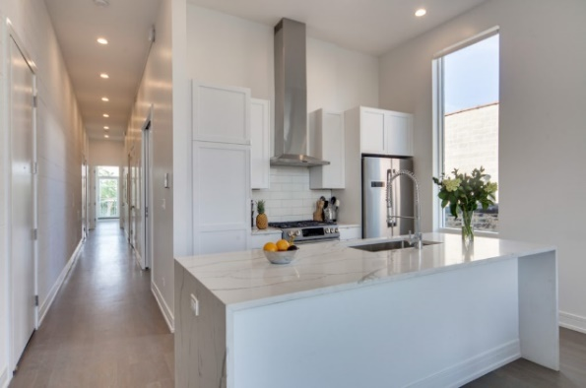
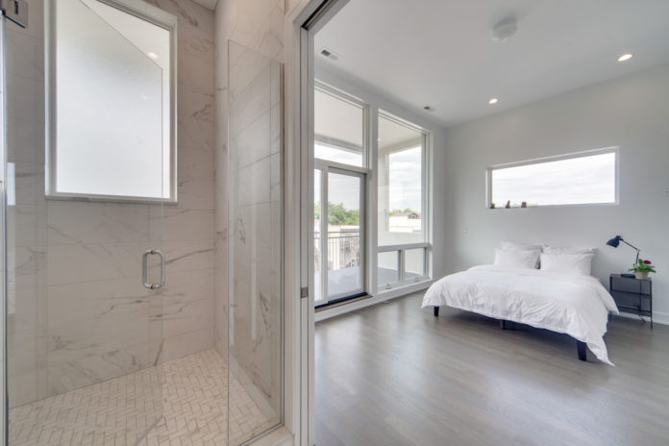

Private Responses: Coliving with Common
    Currently in 6 cities, with 24 homes and 700+ members
    Rent a private bedroom, and all members in the unit have access to shared spaces
    All furniture, linens, cleaning supplies, kitchenware and utilities included with rent
    Weekly cleaning services for shared spaces
    Free on-site laundry with all necessary supplies
    Free high-speed Wi-Fi
    Allows transfers to another room or home within the Common community
  CHICAGO: DAMEN
Source: Yardi® Matrix; common.com

Slide 53
SUMMARY
1
2
3
  New supply is geared toward higher asset classes and is largely unaffordable to median-income renters, and median asking rents are rising faster than inflation, causing widespread affordability issues
  Public and private policy responses are attempting to address the affordability issue; public policy responses differ with some markets restricting supply, and some allowing supply to respond to demand
  Coliving is emerging as a new option for renters in response to limited affordable options available
Source: Yardi® Matrix

Slide 54
NEW TECHNOLOGIES EMERGING

Slide 55


Technology’s Impact on Commercial Real Estate
ALREADY IN PROGRESS
COMING SOON
RESEARCH & DEVELOPMENT
SMART HOME
DIGITAL ASSISTANTS
CHAT BOTS
Automate locks, rekeying, maintenance, guest entry
Alexa, Google Home, Smart AI that will enable digital actions: pay bills, appointments, etc.
Artificial intelligence natural language interactions: calls, emails, chat, helpers
VIRTUAL &
AUGMENTED REALITY
MACHINE LEARNING: EVERYTHING
AUTONOMOUS
TRANSPORTATION
Everything that is developed and deployed will have some form of machine learning behind it: investments, asset management, operations, maintenance, construction
Sell, inspect, repair pre-completion and
post completion
Deliveries, parking, ride-sharing
AI: MACHINE LEARNING
UTILITY OPTIMIZATION
ENERGY
Prescriptive recommendations based on learned patterns and predicted outcomes
Independent monitoring of HVAC and all associated system and independent correction, optimization and fault notification
Batteries and solar energy
Source: Yardi® Matrix

Slide 56
Technology Risks to Keep in Mind
Security
Regulatory burden is so high, people will look to third party providers to manage security of their IoT and AI networks
ALTHOUGH TECHNOLOGY ENABLES A PLUG AND PLAY ABILITY:
Selecting, implementing and managing an enterprise wide “smart” technology platform needs a planned, thoughtful and process-oriented approach to be successful.
Privacy
What is considered “private” and what isn’t?
  It’s a fluid definition
Need to default to a conservative view of privacy
Operational Management
Who’s going to manage all the connected devices?
Who fields support calls?
What happens when something gets disconnected?
Source: Yardi® Matrix

Slide 57



YARDI ELEVATE
RENTCAFÉ CRM
Machine learning based asset management
Machine learned lead scoring & chat bots
YARDI
TECHNOLOGY
ADOPTION
SMART HOME
UTILITY OPTIMIZATION
Raspberry hub: locks, thermostat to start with
Independent monitoring of HVAC and all associated system and independent correction, optimization and fault notification: commercial today
DIGITAL ASSISTANTS
Alexa, Google Home: pay bills
Source: Yardi® Matrix

Slide 58
KEY TAKEAWAYS
ECONOMY
The economy is in decent shape. GDP growth is decelerating but still north of 2%. Slow growth in China and Europe along with a drop in oil prices have brought inflation back to 2%. The yield curve almost inverted, but Fed easing has pulled us back from the brink. The labor market is extremely tight, and wages continue to rise.
MULTIFAMILY MARKET
Demand continues to be strong with jobs and population shifting to lower cost cities and tech hubs. New supply deliveries completed at just under 300,000 units in 2018, and with the constraints of financial and labor costs, 2019 and 2020 deliveries are expected to be flat.
RENT GROWTH
Rent has bounced back from dips in late 2017 to early 2018 and remain around the 3% growth rate nationally with significant variations by city, while occupancy remains stable around 95%.
VALUATIONS AND TRANSACTIONS
Valuations continue to rise at a steady pace with compressed cap rates, and this has shifted the focus to tech hub and tertiary markets to look for potential value add opportunities. Transaction volume in 2018 came in 0.7% lower than 2017, however with 10.8% higher total dollars at $111 billion. The markets where the transactions occurred reflect the shift, as 9% of the transactions occurred in primary markets and 49% in tech hub and 42% in tertiary markets.
DEMOGRAPHIC SHIFTS
As companies and people look for lower cost alternate cities, they drive a shift of both jobs and population to tech hub cities previously not considered. When this happens, real estate will follow. We see this shift happening from urban cores to urbanized suburbs or intellectual capital nodes. The tax reform passed in 2017 will likely accelerate this trend but provide opportunities along the way.
Source: Yardi® Matrix

Slide 59
THANK YOU
FOR ANY QUESTIONS PLEASE FEEL FREE TO CONTACT ME
DHARMENDRA SAWH | 1.800.866.1124 x2074 | DHARMENDRA.SAWH@YARDI.COM

Slide 60
COPYRIGHT NOTICE
This presentation is protected by copyright, trademark and other intellectual property laws. Use of this presentation is subject to the terms and conditions of an authorized Yardi Systems, Inc. software license or other agreement including, but not limited to, restrictions on its use, copying, disclosure, distribution and decompilation. No part of this presentation may be disclosed or reproduced in any form, by any means without the prior written authorization of Yardi Systems, Inc. This presentation contains proprietary information about software and service processes, algorithms, and data models which is confidential and constitutes trade secrets. This presentation is intended for utilization solely in connection with Yardi software licensees’ use of Yardi software and for no other purpose.
NOTICE: Information is subject to change without notice and does not represent a commitment on the part of Yardi Systems, Inc. The following list is not all-inclusive and the absence of a product or service name or logo from this list does not imply a waiver of Yardi’s trademark or other intellectual property rights concerning that name or logo. CHECKscan™, COLLECTplus™, COMMERCIALCafé™, Concierge™, CONDOCafé™, ENERGYplus™, GoodShield®, InvestorPlus™, LeasingKIOSK™, LOBOS®, Marketplace™, MILITARYCafé™, Optimus EMR®, Orion®, PAYplus™, PAYscan™, PopCard®, PowerShopping®, Pulse®, RENTCafé®, Connect™, Creative™, Reach™, TextPay™, Renter Reliability Index™, RentGrow®, RENTmaximizer™, ResidentShield®, ScreeningWorks®, SiteManager™, VENDORCafé®, Voyager®, WIPS®, Yardi Energy Solutions® and Yardi® are either registered trademarks or trademarks of Yardi Systems, Inc. in the United States and/or other countries. All other products mentioned herein may be trademarks of their respective companies.
Design and content © 2019 Yardi Systems, Inc. All Rights Reserved.

Slide 61
DISCLAIMER
Although every effort is made to ensure the accuracy, timeliness and completeness of the information provided in this publication, the information is provided “as is” and Yardi Matrix does not guarantee, warrant, represent or undertake that the information provided is correct, accurate, current or complete. Yardi Matrix is not liable for any loss, claim, or demand arising directly or indirectly from any use or reliance upon the information contained herein.

Slide 62
Notes:
We have an aggressive agenda today with a lot to cover. My goal today is to have you walk away with
1.First, a Broad Update today on the general economy and the overall state of the real estate market
2.Secondly, we will focus on the Commercial Segments and will spotlight a city here in the local market to get a sense of where things stand.
3.Lastly I would like to briefly cover some emerging technologies we think will affect us all as they mature

