Slide 1

Notes:
We have an aggressive agenda today with a lot to cover. My goal today is to have you walk away with
1.First, a Broad Update today on the general economy and the overall state of the real estate market
2.Secondly, we will focus on the Commercial Segments and will spotlight a city here in the local market to get a sense of where things stand.
3.Lastly I would like to briefly cover some emerging technologies we think will affect us all as they mature

Slide 2

OFFICE MARKET UPDATE
DHARMENDRA SAWH
INDUSTRY PRINCIPAL
APRIL 10, 2019
Notes:
Good morning everyone and welcome to our Market Update session today. I would like to start by thanking you for spending part of your day with us to discuss the state of the real estate market.
My name is Dhar Sawh and I have been with Yardi for about 8 years now.

Slide 3
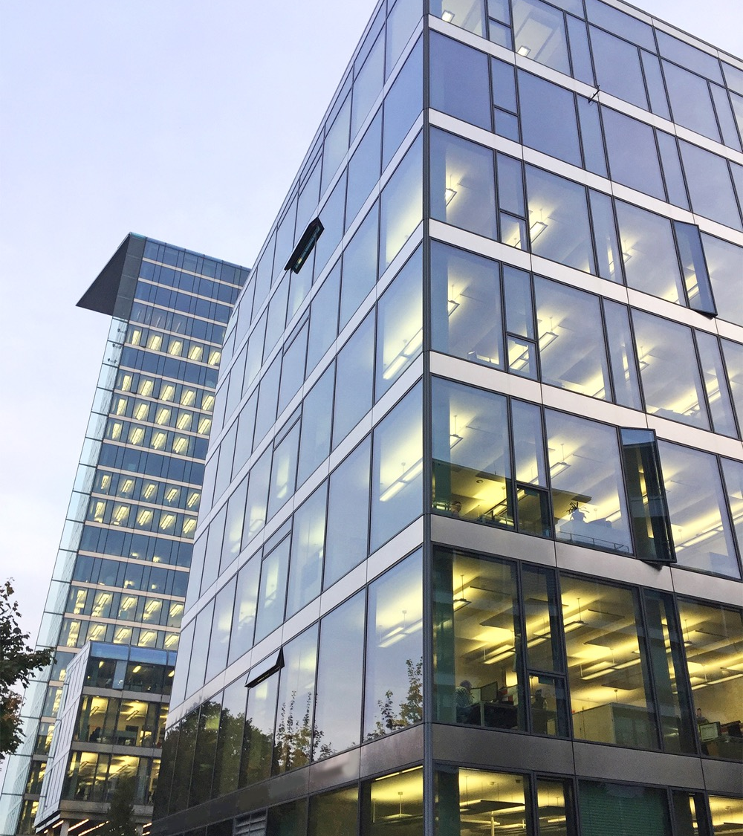
AGENDA
Macroeconomic Outlook
Office Fundamentals & Emerging Trends
Chicago Spotlight
New Technologies Emerging
Notes:
We have an aggressive agenda today with a lot to cover. My goal today is to have you walk away with
1.First, a Broad Update today on the general economy and the overall state of the real estate market
2.Secondly, we will focus on the Commercial Segments and will spotlight a city here in the local market to get a sense of where things stand.
3.Lastly I would like to briefly cover some emerging technologies we think will affect us all as they mature

Slide 4
KEY TAKEAWAYS
ECONOMY
The economy is in decent shape. GDP growth is decelerating but still north of 2%. Slow growth in China and Europe along with a drop in oil prices have brought inflation back to 2%. The yield curve almost inverted, but Fed easing has pulled us back from the brink. The labor market is extremely tight, and wages continue to rise.
COMMERCIAL MARKET
Demand is steady with job growth in office-using industries outpacing other industries. Completions peaked in 2018, but a lot of markets still have room for absorption. There are secular pressures that continue to alter the office market, such as decreasing square footage per employee, coworking, and a changing talent pool for office-using employment.
LISTING RATE GROWTH
Most Matrix markets showed moderate rate growth over the past six months, but some have seen lease rates fall – Brooklyn, Denver, Atlanta, Boston. Conditions are sufficient to maintain this pace of slow occupancy and lease rate growth in most markets.
TRANSACTIONS
Sales volume peaked in 2015 and has been dropping ever since. This is across all markets categories. However, sales prices per sq. ft. have increased nationally since 2000, with tech hub markets having the most growth over the past ten years.
DEMOGRAPHIC SHIFTS
As companies and people look for lower cost alternate cities, they drive a shift of both jobs and population to tech hub cities previously not considered. When this happens, real estate will follow. We see this shift happening from urban cores to urbanized suburbs or intellectual capital nodes.
Source: Yardi®Matrix

Slide 5

GDP and employment will continue to grow, but at a slower, steadier pace
A steady economy coupled with the demographic shift of jobs will continue to create demand in tech hub cities, providing a solid base for office-using sectors
There are secular pressures that continue to alter the office market, such as decreasing square footage per employee, coworking, and a changing talent pool for office-using employment
The use of new technology is already impacting commercial space in help with costs, especially around utility consumption. This will accelerate as the technologies are more widely adopted
It’s a sharpshooter’s game
2019 OUTLOOK
Source: Yardi® Matrix
Notes:
So, to begin with, what are we seeing?
The U.S. economy is good and looks like it will continue to grow at a slower but steady pace.
GDP and employment are up and maintaining a good pace (most recent jobs numbers were above expectations) and we are seeing sustained wage growth which is good for the office sector.
Along with the demographic shifts, the per sq. ft. per employee contraction and coworking sector will have an impact on how much and in what form office is impacted.

Slide 6
MACROECONOMIC OUTLOOK

Slide 7
U.S. Economic Growth is Good but Moderating
Source: Yardi® Matrix; Moody’s Analytics; Bureau of Labor Statistics (BLS); S&P Dow Jones Indices LLC; CoreLogic, Inc; Federal Housing Agency (FHFA); Freddie Mac; Fannie Mae; U.S. Bureau of Economic Analysis (BEA); U.S. Board of Governors of the Federal Reserve System (FRB); Investing.com; Federal Reserve Bank of Atlanta
Notes:
GDP – 1/30 update for Q4 data
CCI – 1/29 for Jan data
As I mentioned before, GDP is still above 2% and consumer confidence is still rising even with a slower fourth quarter in 2018.

Slide 8
Tight Labor Market, Pulling People Off the Sidelines
  It is difficult to find labor at the right price, with the right skills, in the right city
Preliminary Jan. 2019: 311,000
Preliminary Feb. 2019: 20,000
Currently less than one unemployed person for every one job opening
*Through December 2018
Source: Yardi® Matrix; Moody’s Analytics; Bureau of Labor Statistics (BLS); The Conference Board
Notes:
Continuing on the labor market, we continue to see good job growth with there being less than one resource per job opening. In January’s jobs report, the number of jobs created exceeded expectation.
This makes it hard to find the right skills for the jobs and so companies are starting to pull people off of the sidelines back into the workforce.
Now you have to go find the resources you need for the job, this is a workforce market…

Slide 9
Wage Growth Finally Emerging
  Feb: 3.4%
  Feb: 3.8%
Source: Yardi® Matrix; Moody’s Analytics; Bureau of Labor Statistics (BLS); Current Population Survey (CPS);
Notes:
https://www.frbsf.org/our-district/about/sf-fed-blog/wage-growth-good-news/
This creates the situation where the demand for workers outweighs the resources available to work putting upward pressure on wages.
As an interesting note, the actual wage growth is masked by the workforce substitution that is happening with older, higher paid workers retiring and being replaced by younger workers at the lower end of the salary range.

Slide 10
Office-Using Sectors Outpaced Overall
Job Growth Over the Last Five Years
CAGR
Sector | Feb 2019 Unemployment Rate
Construction | 6.2%
Leisure & Hospitality | 5.8%
Wholesale & Retail Trade | 5.0%
Professional & Business Services | 4.3%
Transportation & Utilities | 4.1%
Information | 4.1%
Mining | 3.6%
Manufacturing | 2.9%
Financial Activities | 2.6%
Education & Healthcare | 2.5%
Government | 1.8%
  5-Year CAGR:
  Office-using sectors: 2.1%
  Total non-farm: 1.8%
  Feb 2018-Feb 2019:
  Office-using sectors: 2.0%
  Total non-farm: 1.7%
*February 2014-February 2019, Boxed labels are office-using sectors
Source: Yardi® Matrix; Moody’s Analytics; Bureau of Labor Statistics (BLS)
Notes:
In office, the has been good growth across most sectors with emphasis in the high tech sectors that use office space.

Slide 11
Office-Using Sectors Exhibit the Most
Wage Growth Over the Last Five Years
CAGR
  5-Year CAGR:
  Office-using sectors: 3.5%
  Total non-farm: 2.8%
  Feb 2018-Feb 2019:
  Office-using sectors: 4.7%
  Total non-farm: 3.6%
*February 2014-February 2019, Boxed labels are office-using sectors
Source: Yardi® Matrix; Moody’s Analytics; Bureau of Labor Statistics (BLS)
Notes:
And that is also accompanied with the best wage growth in those sectors as well providing a good foundation to the office utilization.
This shows good fundamentals for the office sectors even with the effects of outsourcing, telecommuting and coworking.
Green sectors have highest wage growth that can afford Class A rents.

Slide 12
Job Growth is Happening in Tech Hub Markets
At this stage in the economy, companies are relocating and expanding in markets where their money will get them further
Market | Emp. Growth Feb ‘18-Feb ‘19 | Trend From Prior Year
Reno | 5.9% | Accelerating
Boise | 4.3% | Decelerating
San Francisco | 3.8% | Accelerating
Orlando | 3.6% | Accelerating
Phoenix | 3.1% | Decelerating
Dallas | 3.1% | Accelerating
Nashville | 3.0% | Decelerating
Las Vegas | 2.8% | Decelerating
Sacramento | 2.7% | Decelerating
Houston | 2.4% | Accelerating
Charlotte | 2.3% | Decelerating
San Jose | 2.2% | Accelerating
Atlanta | 2.2% | Accelerating
Tampa | 2.2% | Accelerating
Miami | 2.2% | Accelerating
Salt Lake City | 2.1% | Decelerating
Austin | 2.1% | Decelerating
West Palm Beach | 2.0% | Accelerating
Fort Lauderdale | 2.0% | Accelerating
Seattle | 1.9% | Decelerating
Portland | 1.8% | Decelerating
Market | Emp. Growth Feb ‘18-Feb ‘19 | Trend From Prior Year
North Central Florida | 1.7% | Decelerating
Denver | 1.7% | Decelerating
New York | 1.4% | Decelerating
Columbus | 1.3% | Decelerating
San Diego | 1.3% | Decelerating
Chicago | 1.3% | Accelerating
East Bay Area | 1.2% | Decelerating
Jacksonville | 1.1% | Decelerating
Philadelphia | 1.1% | Decelerating
Inland Empire | 1.0% | Decelerating
Detroit | 1.0% | Decelerating
Raleigh | 1.0% | Decelerating
Milwaukee | 0.9% | Decelerating
Los Angeles | 0.7% | Decelerating
St. Louis | 0.7% | Accelerating
Orange County | 0.7% | Decelerating
Kansas City | 0.7% | Decelerating
Indianapolis | 0.7% | Decelerating
Washington DC | 0.5% | Decelerating
Boston | 0.2% | Decelerating
Minneapolis | 0.2% | Decelerating
Charles Schwab
  Relocated jobs from San Francisco to lower-cost states like Texas and Colorado
  Consolidated Denver-area employees and newly relocated employees into a $230 million campus in Lone Tree, CO
  Light rail currently being extended in part to accommodate employees and other residents drawn to the area
  KPMG
  Developing $400 million, 55-acre learning, development and innovation campus in Lake Nona outside of Orlando
  Create 330 new jobs and 800,000 sq. ft. for meeting, classroom, residential and dining
Source: Yardi® Matrix; Moody’s Analytics; Bureau of Labor Statistics; kpmg.com; denverpost.com
Notes:
As we mentioned earlier, there is a shift happening as companies are looking to lower-cost cities for highly educated workforce and desirable places to live, driving jobs to secondary markets.

Slide 13
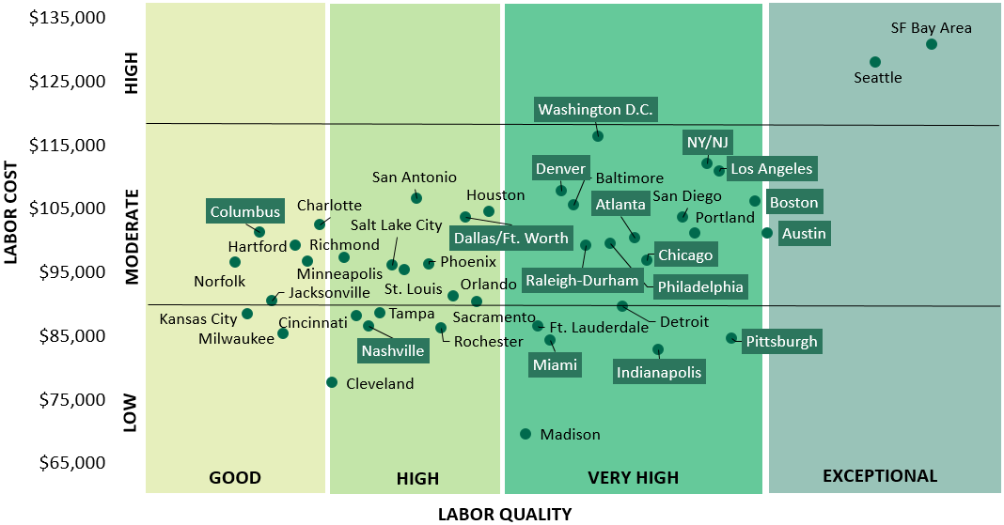
Tech Talent Quality vs. Cost Analysis
    AVERAGE ANNUAL SALARY FOR SOFTWARE ENGINEER (USD)
*Boxed markets are part of the Amazon 20 finalists
Source: Yardi® Matrix; CBRE Research, 2018; CBRE Labor Analytics; U.S. Bureau of Labor Statistics (BLS); Statistics Canada, April 2018; U.S. News & World Report
Notes:
If we take a look at the cost of tech talent against the quality of the labor you can easily see the high cost hubs that has exceptional talent, as well as the lower cost hubs with high quality talent.
This is helping to facilitate that shift of both jobs and population to these tech hubs.

Slide 14
Inflation Rising, But Unlikely to Break Out >2.5%
*YOY 6-month moving avgs. CPI Less Health Care, Education and Rent
is an estimate using BLS document “Math calculations to better utilize CPI data”
Source: Yardi® Matrix; Moody’s Analytics; Bureau of Labor Statistics (BLS)
Notes:
One of the major drivers to the feds policy over interest rates is inflation. As I mentioned at the top, the recent slowing both globally and here at home has tempered the rate of inflation and has influenced the Feds outlook to a more conservative approach from what their view was in Q3 of 2018.

Slide 15
U.S. and International Financial Market
A breakout >3% is significant
+0.3% YOY
-23 bps
-23 bps
Source: Yardi® Matrix; Moody’s Analytics; Investing.com

Slide 16
U.S. Federal Policy Mix is Mildly Pro-Growth –
Shifting Away From Consumers Towards Producers
PRO-GROWTH
PRO-GROWTH BUT SLOW
ANTI-GROWTH
Tax Reform
Regulatory Relief
Executive Orders
  Energy
  Finance
  Labor Costs
Infrastructure
Education Reform
  German Model
Healthcare Reform
Immigration Control
Trade Renegotiation
  President Trump announced U.S. will impose tariffs on steel and aluminum imports
GENERALLY
POSITIVE
PROGRESS
PROGRESS IN TONE,
BUT NOT YET
SUBSTANTIVE
RECENT TARIFF MOVE
A POTENTIAL DRAG
ON GROWTH
Source: Yardi® Matrix
Notes:
There are some other areas that will affect the cycle and that is mainly around policy. The current administration’s policies are a mix on growth.
The clear pro-growth components are the tax cuts and de-regulation actions whereas the policies that will slow growth (at least in the short term) are immigration and trade.

Slide 17
SUMMARY
1
2
3
The U.S. economy is strong
Employment and wage growth are good
How much slack is left?
Productivity
Job Growth
4
5
Inflation rising but not a lot, so the 10-yr rate is the binding constraint on the yield curve
Fiscal policy is mildly pro-growth
Capital still needs to be deployed
Source: Yardi® Matrix

Slide 18
OFFICE FUNDAMENTALS & EMERGING TRENDS

Slide 19
Office Supply Additions Peaked in 2018
Source: Yardi® Matrix
Notes:
On the office side, new supply was expected to peak in 2018 and looking at 2019, delivers are expected to come in around?????

Slide 20
Most Markets are Absorbing Office Space
Source: Yardi® Matrix

Slide 21
Office Sales Volume Dropping in Each Market Category
Source: Yardi® Matrix
Notes:
However, overall sales volumes have been dropping indicating pressure from other forces.

Slide 22
Since the Recession, Class A Has Outperformed B/C
*12-month rolling avg. sales price per sq. ft. index 2008 = 100
Source: Yardi® Matrix

Slide 23
Office Assets in Gateway Markets
Have Outperformed Since 2000, but…
  Gateway Markets 18-Year CAGR: 4.5%
  Tech Hub Markets 18-Year CAGR: 3.6%
*Index 2000 = 100
Source: Yardi®Matrix
Notes:
In commercial office space, gateway markets have performed well, however,

Slide 24
Office Assets in Tech Hub Markets Have
Performed In Line with Gateway Markets Since 2009
  Tech Hub Markets 10-Year CAGR: 4.9%
  Gateway Markets
  10-Year CAGR: 4.9%
*Index 2009 = 100
Source: Yardi®Matrix
Notes:
If you look at tech hub markets from 2008 to now, office space in tech hub markets have outperformed primary markets. This ties in with the trends we are seeing in emergence and development of tech hubs mentioned earlier.

Slide 25
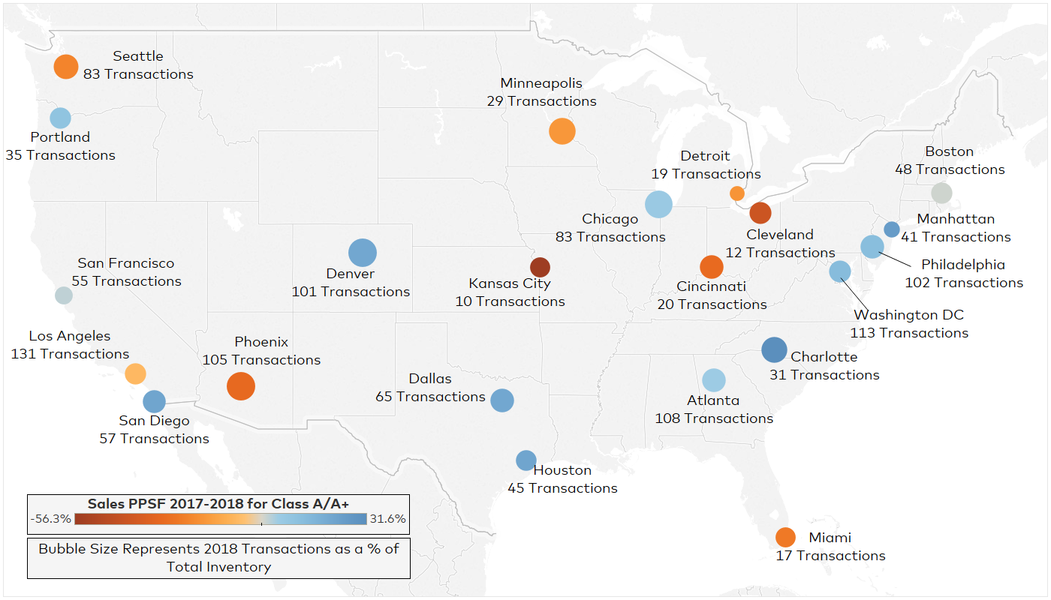
Office Transactions in 2018
*2018 transactions do not include portfolio sales or foreclosures that do not have an associated purchase price
Source: Yardi® Matrix; Tableau

Slide 26
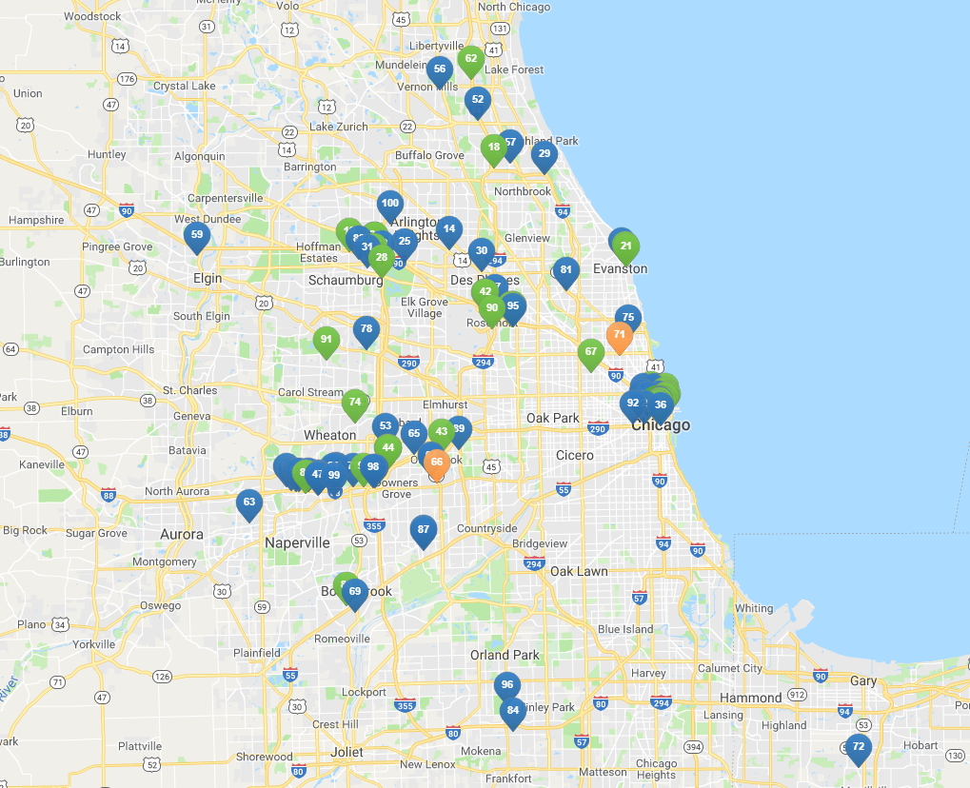

Chicago’s Office Transaction Composition in 2018
2018 Transactions
 | # | % of Stock
Properties Sold | 83 | 7.0%
Sq. Ft. Sold | 28,043,366 | 9.7%
2018 Sales Prices
Avg. Sales Price per Sq. Ft. | $214.55
Avg. Sales Price per Sq. Ft. for Class A+/A Assets | $252.76
1-Year Sales Price per Sq. Ft. Growth for Class A+/A Assets | 7.0%
5-Year Sales Price per Sq. Ft. Growth for Class A+/A Assets | -1.8%
  Building Class:
*2018 transactions do not include portfolio sales or foreclosures that do not have an associated purchase price
Source: Yardi® Matrix; Tableau

Slide 27
Office Fundamentals Improving in Tech Hub Markets
Top 10 Markets
Market | 6-Month Change in Full-Service Equivalent Asking Rents | 6-Month Change in Availability Rate | February Full-Service Equivalent Asking Rent | February Availability Rate | New Supply as a % of Stock Last 12 months
Southwest Florida Coast | 11.0% | -1.8% | $25.76 | 11.1% | 1.4%
Bay Area | 9.9% | -1.5% | $45.59 | 15.1% | 1.5%
Boston | 8.1% | -0.2% | $37.85 | 9.9% | 0.8%
Jacksonville | 6.5% | 2.1% | $21.63 | 14.9% | 0.5%
Philadelphia | 6.4% | 0.5% | $29.37 | 12.7% | 1.6%
San Francisco | 4.9% | 0.5% | $58.87 | 9.0% | 3.1%
Central Valley | 4.3% | -2.0% | $25.57 | 9.4% | 0.0%
Los Angeles | 4.3% | -1.3% | $37.69 | 13.1% | 0.3%
Nashville | 2.5% | 0.4% | $28.12 | 11.1% | 0.6%
Atlanta | 2.1% | 0.4% | $26.01 | 16.5% | 0.9%
*As of Feb. 2019
Source: Yardi® Matrix
Notes:
Consequently, there is a corresponding growth in Office in those tech hubs that the migration is happening in.
This is a list of markets ranked by change in asking rents.

Slide 28
Office Fundamentals Improving in Tech Hub Markets
Bottom 10 Markets
Market | 6-Month Change in Full-Service Equivalent Asking Rents | 6-Month Change in Availability Rate | February Full-Service Equivalent Asking Rent | February Availability Rate | New Supply as a % of Stock Last 12 months
Brooklyn | -18.2% | -1.5% | $47.66 | 7.9% | 0.3%
Winston-Salem | -7.4% | 0.5% | $17.27 | 17.4% | 0.2%
Portland | -3.5% | 1.7% | $28.10 | 13.0% | 2.9%
Orlando | -3.2% | 1.6% | $21.01 | 13.6% | 1.0%
Pittsburgh | -2.9% | 1.4% | $23.13 | 14.5% | 0.2%
Fort Lauderdale | -2.8% | 1.0% | $28.41 | 14.9% | 0.5%
Inland Empire | -2.3% | 0.5% | $22.55 | 13.2% | 0.8%
Austin | -2.2% | -1.8% | $35.88 | 9.1% | 3.4%
Kansas City | -2.0% | 3.7% | $20.59 | 16.2% | 0.7%
Denver | -1.8% | -0.3% | $27.90 | 13.9% | 1.7%
*As of Feb. 2019
Source: Yardi® Matrix
Notes:
Consequently, there is a corresponding growth in Office in those tech hubs that the migration is happening in.
This is a list of markets ranked by change in asking rents.

Slide 29

Secular Pressures Continue to Alter the Office Market
Talent pool for office-using employment – office is becoming more about the experience
    Diversifying and moving to lower cost markets
Coworking
    Pulls roughly 1-3% of market demand from traditional office leases
    More highly concentrated in dense, high cost gateway markets
Decreasing square foot per employee
    Specifically in CBD and high cost metros
Capital expenditures are rising in office assets as the labor market tightens and office space becomes a draw for talent
Source: Yardi® Matrix

Slide 30
Capital Expenditures Rising as Office
Space Becomes a Draw for Top Talent
OFFICE | Urban Chicago | Denver | Atlanta | Austin | Boston | Manhattan | Seattle | Washington DC | Miami
Net Operating Income | $12.47 | $12.89 | $12.26 | $18.42 | $23.42 | $31.19 | $23.54 | $21.25 | $18.59
CapEx | $6.16 | $3.73 | $4.39 | $3.77 | $5.96 | $6.62 | $4.45 | $4.22 | $4.22
CapEx as a % of NOI | 49.4% | 28.9% | 35.8% | 20.5% | 25.4% | 21.2% | 18.9% | 19.9% | 22.7%
MULTIFAMILY | Urban Chicago | Denver | Atlanta | Austin | Boston | Manhattan | Seattle | Washington DC | Miami
Net Operating Income | $11,613 | $11,314 | $8,345 | $7,128 | $13,991 | $19,503 | $13,212 | $10,947 | $11,505
CapEx | $1,967 | $2,321 | $1,946 | $1,500 | $1,762 | $2,240 | $1,395 | $1,415 | $1,230
CapEx as a % of NOI | 16.9% | 20.5% | 23.3% | 21.0% | 12.6% | 11.5% | 10.6% | 12.9% | 10.7%
*12 months ending Jan 2019
Source: Yardi® Matrix Expert

Slide 31
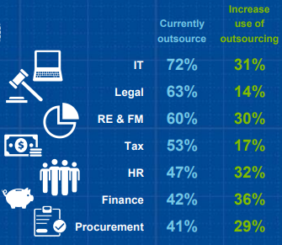
Coworking Trend Reducing Demand for Office Space
COWORKING, TELECOMMUTING AND OUTSOURCING
Telecommuting
Work-at-home population has grown by 115% since 2005
  Nearly 10x faster than the rest of the workforce
3.7 million employees (2.8% of workforce) now work from home at least half the time
Outsourcing
Companies outsource to cut costs, focus on core business and solve capacity issues
What are your current and future outsourcing strategies for the various business functions?
Small but growing
Impacts demand at the margins
*Telecommuting data as of June 2017 *Outsourcing data as of Jan 2016
Source: Yardi® Matrix; GlobalWorkplaceAnalytics.com; 2016 Global Outsourcing Survey by Deloitte
Notes:
And what are those forces? Coworking is the latest strong impact adding to the impacts of Telecommuting and Outsourcing.
Coworking is small now but will grow to be a much bigger impact, but has a side benefit to office use. There is a shift to use vacant office use as coworking space where location provides an advantage to commute times.

Slide 32
Markets With Lower Vacancy Rates Have
Higher Proportion of Coworking Space
Higher Vacancy, Lower % Coworking
Lower Vacancy, Higher % Coworking
*As of December 2018
Source: Yardi® Matrix
Notes:
There is more use of coworking in higher occupancy markets as operators try optimize any vacant space they have.
Cost is driving this.
++ Summary slide?

Slide 33
Two Industry Giants Dominate Coworking,
but CBRE Just Entered with Hana
*As of January 2018
Source: Yardi® Matrix
Notes:
Today, we have 2 dominant players I coworking, but more players will enter the arena as CBRE just did.

Slide 34
SUMMARY
1
2
3
New supply peaked in 2018, and various factors are reducing demand for office space
Coworking, telecommuting, outsourcing
Tech hub markets have outperformed over the past six months, with rising asking rents in markets such as Salt Lake City, Bay Area,
San Francisco, Seattle and Atlanta
Transactions are falling nationally, but sales prices have been increasing
Sales prices per sq. ft. increased the most in gateway markets since 2000, however, tech hub markets have outperformed since 2008, further indicating that the timing of investment is key
Source: Yardi® Matrix

Slide 35
CITY SPOTLIGHT

Slide 36
What Helps a City Reach Its Critical Point to Succeed?
    ALL EXISTING TECH MARKETS HAVE THESE CHARACTERISTICS TO SOME DEGREE
PUBLIC & PRIVATE PARTNERSHIPS
FRIENDLY BUSINESS ENVIRONMENT
COMMUNITY & AMENITIES THAT RETAIN & DRAW IN TALENT
EDUCATED WORKFORCE
*A workbook of major U.S. markets is available to clients upon request
Source: Yardi® Matrix

Slide 37
What’s Going on in Chicago?
PUBLIC & PRIVATE PARTNERSHIPS
Express service from downtown Chicago to O’Hare International to be privately financed through a public-private partnership with Elon Musk’s Boring Company
Chicago’s Skyway Bridge operating lease was purchased by Canada’s three largest pension plans for $2.8 billion
  Initial upfront payment from original lessee allowed the city to establish a $100 million people, neighborhood, and business investment fund
FRIENDLY BUSINESS ENVIRONMENT
State Rank #39
Despite incentives, tax credits and exemptions to encourage business growth, not business friendly
Illinois Governor signed bill to raise the minimum wage to $15 from $8.25 per hour by 2025
Flat corporate and personal income tax rates of 5.25% and 4.95%, respectively; Gov proposed amendments to repeal
COMMUNITY & AMENITIES THAT
RETAIN & DRAW IN TALENT
The 606 is a P3-financed park and trail system bringing together the arts, history, recreation paths, event spaces, alternative transportation avenues and green spaces for residents in the area
Maggie Daley Park offers a variety of outdoor recreation including a skate park, ice skating rink, climbing walls and picnic areas among many others
EDUCATED WORKFORCE
37.5% of adults in the city of Chicago have a bachelor’s degree or higher
University | Approx. Enrollment 2018
University of Illinois at Chicago | 31,683
Northwestern University | 21,421
Loyola University | 17,007
The University of Chicago | 16,514
DePaul University | 14,507
Source: Yardi® Matrix; uchicago.edu; northwestern.edu; luc.edu; uic.edu; depaul.edu; colum.edu; census.gov; thehill.com; forbes.com; illinois.gov; chicagobusiness.com; bipartisanpolicy.org; the606.org; maggiedaleypark.com; boringcompany.com

Slide 38
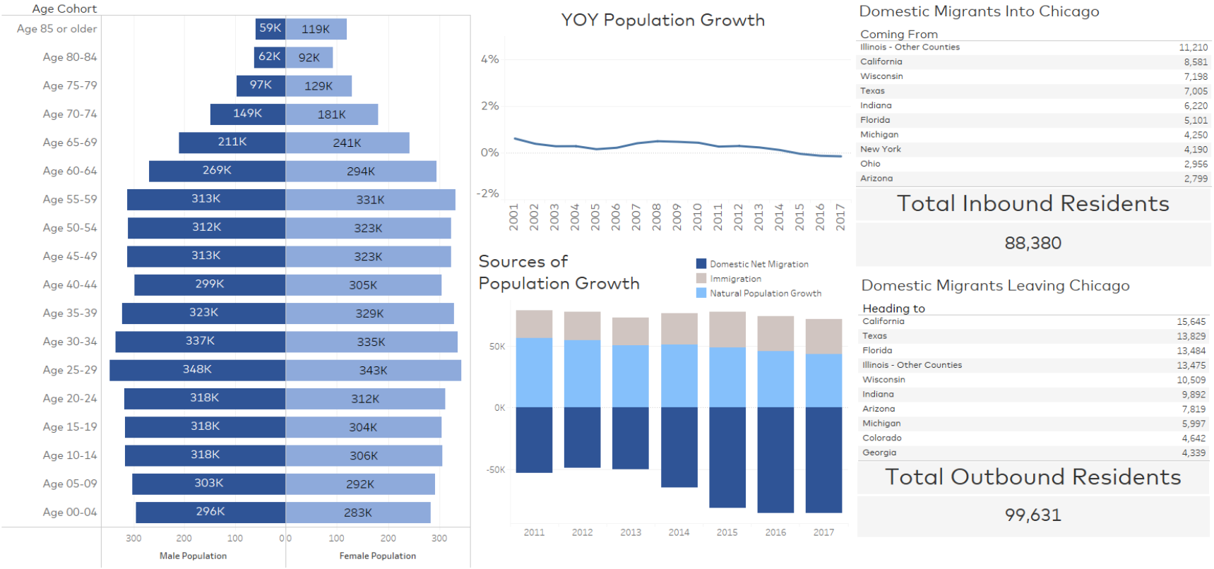
Chicago Demographics Overview
*County-level data; Migration data as of 2016
Source: Yardi® Matrix

Slide 39
Chicago Employment Growth Feb 2014 – Feb 2019
CAGR
  5-Year Employment Growth
  National: 9.3%
  Chicago: 6.9%
  5-Year Wage Growth
  National: 13.7%
  Chicago: 14.7%
Source: Yardi® Matrix; Moody’s Analytics; Bureau of Labor Statistics (BLS)

Slide 40
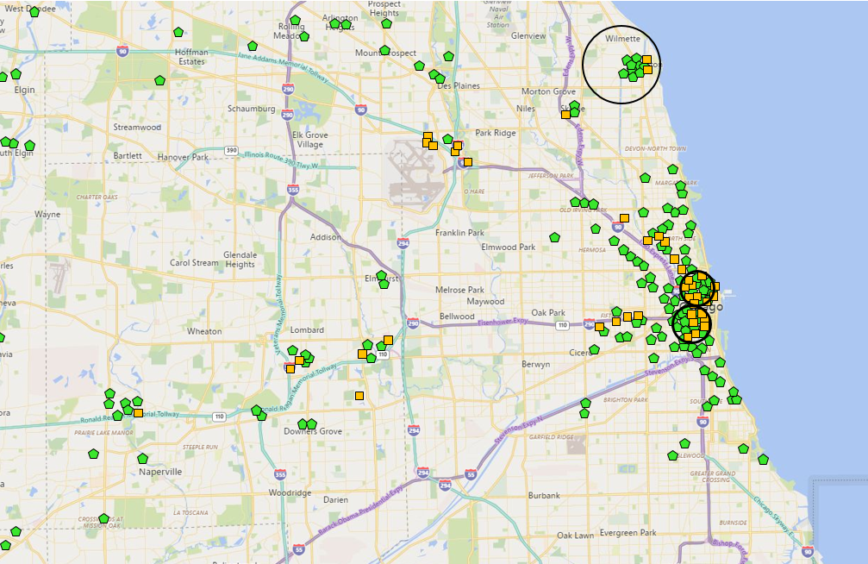
Chicago’s Intellectual Capital Nodes
Evanston
Multifamily
20% Rent Growth
32% Supply Growth
-1.7% Occupancy Change
Office
1,739,615 sq. ft.
0.5% of total inventory
Chicago Metro
Multifamily
24% Rent Growth
16% Supply Growth
-0.2% Occupancy Change
Office
290,585,106 sq. ft.
West Loop
Multifamily
30% Rent Growth
45% Supply Growth
0.6% Occupancy Change
Office
39,319,179 sq. ft.
13.5% of total inventory
Fulton Market/River North
Multifamily
15% Rent Growth
61% Supply Growth
1.0% Occupancy Change
Office
23,094,284 sq. ft.
7.9% of total inventory
Office Development
Multifamily Development
*Multifamily rent growth based on Feb. 2014 through Feb. 2019
*Change in multifamily occupancy based on Feb. 2018 through Feb. 2019
Source: Yardi® Matrix

Slide 41
Chicago’s Office Fundamentals
Asset Class | Count | Sq. Ft. (Thous.) | Direct Sq. Ft. Available (Thous.) | Sublease Sq. Ft. Available (Thous.) | Total Sq. Ft. Available (Thous.) | Direct Asking Rate | Market Asking Rate | Direct Vacancy | Sublease Vacancy | Overall Vacancy
A & A+ | 379 | 157,966 | 16,922 | 1,058 | 18,031 | $33.49 | $34.64 | 12.0% | 0.7% | 12.8%
B | 774 | 117,003 | 15,839 | 1,254 | 17,173 | $24.36 | $24.33 | 17.7% | 1.3% | 19.1%
C | 30 | 4,169 | 1,290 | <1 | 1,328 | $18.51 | $18.51 | 34.5% | 0.0% | 35.5%
TOTAL | 1,183 | 279,138 | 34,051 | 2,312 | 36,532 | $28.79 | $29.86 | 14.5% | 0.9% | 15.6%
*As of Feb. 2019
Source: Yardi® Matrix

Slide 42
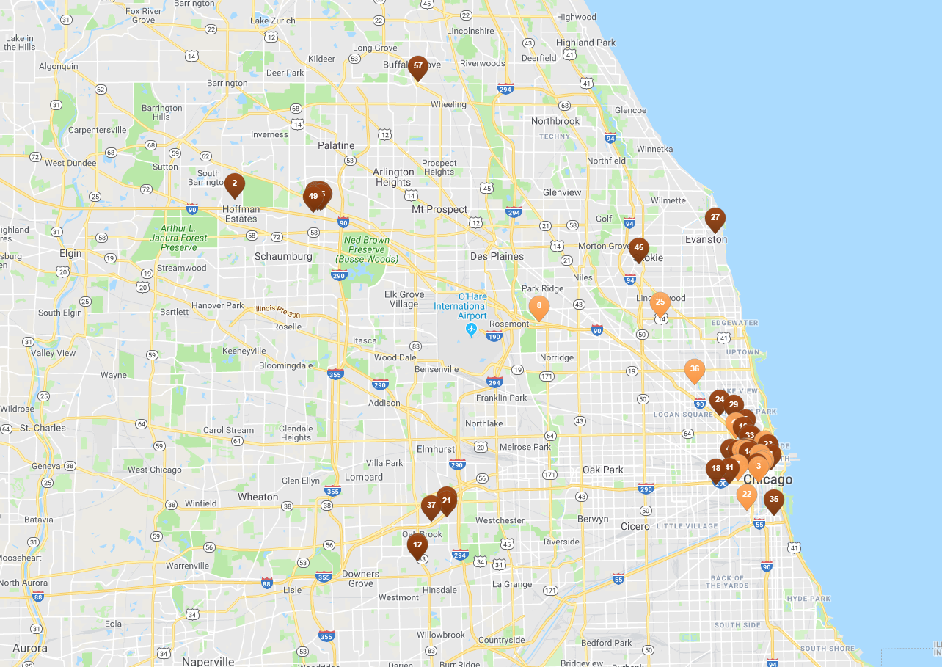

Chicago Development Pipeline
*As of March 2019
Source: Yardi® Matrix

Slide 43
Top 5 Submarkets With Construction
Activity as a Percentage of Existing Stock
Submarket | Sq. Ft. Under Construction | % of Existing Stock
Northwest Chicago | 84,433 | 22.4%
West Loop | 821,295 | 14.7%
West Side | 120,000 | 6.1%
Outlying Lake County | 59,720 | 4.0%
Chicago CBD | 5,053,320 | 3.5%
Chicago Market | 6,759,768 | 2.3%
*As of March 2019
Source: Yardi® Matrix

Slide 44
SUMMARY
1
2
3
Despite incentives, tax credits and exemptions to encourage business growth, Chicago is not very business friendly. However, it is still an attractive market for many people and businesses who desire a big city.
Employment growth in Chicago is lagging national rates, though wages grew faster in Chicago than the nation over the last five years. Education and healthcare added the most jobs since 2014, and transportation and utilities had the greatest employment growth percentage over the same time period.
Office fundamentals remain positive, with class A & A+ greatly outperforming B and C assets with significantly higher asking rates and lower vacancy rates.
Source: Yardi® Matrix

Slide 45
NEW TECHNOLOGIES EMERGING

Slide 46


Technology’s Impact on Commercial Real Estate
ALREADY IN PROGRESS
COMING SOON
RESEARCH & DEVELOPMENT
UTILITY OPTIMIZATION
MACHINE LEARNING: EVERYTHING
AUTONOMOUS TRANSPORTATION
Independent monitoring of HVAC and all associated system and independent correction, optimization and fault notification
Everything that is developed and deployed will
have some form of machine learning behind it: investments, asset management, operations, maintenance, construction
Deliveries, parking, ride-sharing
VIRTUAL & AUGMENTED REALITY
ENERGY
Sell, inspect, repair pre-completion and
post completion
Batteries and solar energy
SMART BUILDING
Automate locks, rekeying, maintenance,
guest entry
Source: Yardi® Matrix

Slide 47
Technology Risks to Keep in Mind
Security
Regulatory burden is so high, people will look to third party providers to manage security of their IoT and AI networks
ALTHOUGH TECHNOLOGY ENABLES A PLUG AND PLAY ABILITY:
Selecting, implementing and managing an enterprise wide “smart” technology platform needs a planned, thoughtful and process oriented approach to be successful.
Privacy
What is considered “private” and what isn’t?
  It’s a fluid definition
Need to default to a conservative view of privacy
Operational Management
Who’s going to manage all the connected devices?
Who fields support calls?
What happens when something gets disconnected?
Source: Yardi® Matrix

Slide 48



YARDI ELEVATE
RENTCAFÉ CRM
Machine learning based asset management
Machine learned lead scoring & chat bots
YARDI
TECHNOLOGY
ADOPTION
SMART HOME
UTILITY OPTIMIZATION
Raspberry Hub: locks, thermostat to start with
Independent monitoring of HVAC and all associated system and independent correction, optimization and fault notification: commercial today
DIGITAL ASSISTANTS
Alexa, Google Home: pay bills
Source: Yardi® Matrix

Slide 49
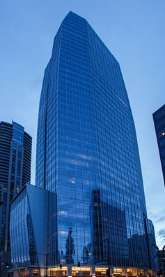



IoT in Office Case Study
Leak Detection
Leak detectors throughout building, along with system lining basement walls to detect water
  Helps management figure out where leaks occur
IoT Automation
Public spaces include sensors to track movement and reduce energy usage
Smart elevator system
  When a floor is selected on the elevator screen, system optimizes the movement of elevator cars to maximize the amount of people moving around – reduces energy load
Tenant Comfort
Tenants can control their lease space through their machines
  Ex: automatic shading feature
40-story high-rise completed in
March 2018
Source: Yardi® Matrix; IvyLee Rosario, “Denver’s New Heights”, cpexecutive.com

Slide 50
KEY TAKEAWAYS
ECONOMY
The economy is in decent shape. GDP growth is decelerating but still north of 2%. Slow growth in China and Europe along with a drop in oil prices have brought inflation back to 2%. The yield curve almost inverted, but Fed easing has pulled us back from the brink. The labor market is extremely tight, and wages continue to rise.
COMMERCIAL MARKET
Demand is steady with job growth in office-using industries outpacing other industries. Completions peaked in 2018, but a lot of markets still have room for absorption. There are secular pressures that continue to alter the office market, such as decreasing square footage per employee, coworking, and a changing talent pool for office-using employment.
LISTING RATE GROWTH
Most Matrix markets showed moderate rate growth over the past six months, but some have seen lease rates fall – Brooklyn, Denver, Atlanta, Boston. Conditions are sufficient to maintain this pace of slow occupancy and lease rate growth in most markets.
TRANSACTIONS
Sales volume peaked in 2015 and has been dropping ever since. This is across all markets categories. However, sales prices per sq. ft. have increased nationally since 2000, with tech hub markets having the most growth over the past ten years.
DEMOGRAPHIC SHIFTS
As companies and people look for lower cost alternate cities, they drive a shift of both jobs and population to tech hub cities previously not considered. When this happens, real estate will follow. We see this shift happening from urban cores to urbanized suburbs or intellectual capital nodes.
Source: Yardi®Matrix

Slide 51
THANK YOU
FOR ANY QUESTIONS PLEASE FEEL FREE TO CONTACT ME
DHARMENDRA SAWH | 1.800.866.1124 x2074 | DHARMENDRA.SAWH@YARDI.COM

Slide 52
COPYRIGHT NOTICE
This presentation is protected by copyright, trademark and other intellectual property laws. Use of this presentation is subject to the terms and conditions of an authorized Yardi Systems, Inc. software license or other agreement including, but not limited to, restrictions on its use, copying, disclosure, distribution and decompilation. No part of this presentation may be disclosed or reproduced in any form, by any means without the prior written authorization of Yardi Systems, Inc. This presentation contains proprietary information about software and service processes, algorithms, and data models which is confidential and constitutes trade secrets. This presentation is intended for utilization solely in connection with Yardi software licensees’ use of Yardi software and for no other purpose.
NOTICE: Information is subject to change without notice and does not represent a commitment on the part of Yardi Systems, Inc. The following list is not all-inclusive and the absence of a product or service name or logo from this list does not imply a waiver of Yardi’s trademark or other intellectual property rights concerning that name or logo. CHECKscan™, COLLECTplus™, COMMERCIALCafé™, Concierge™, CONDOCafé™, ENERGYplus™, GoodShield®, InvestorPlus™, LeasingKIOSK™, LOBOS®, Marketplace™, MILITARYCafé™, Optimus EMR®, Orion®, PAYplus™, PAYscan™, PopCard®, PowerShopping®, Pulse®, RENTCafé®, Connect™, Creative™, Reach™, TextPay™, Renter Reliability Index™, RentGrow®, RENTmaximizer™, ResidentShield®, ScreeningWorks®, SiteManager™, VENDORCafé®, Voyager®, WIPS®, Yardi Energy Solutions® and Yardi® are either registered trademarks or trademarks of Yardi Systems, Inc. in the United States and/or other countries. All other products mentioned herein may be trademarks of their respective companies.
Design and content © 2019 Yardi Systems, Inc. All Rights Reserved.

Slide 53
DISCLAIMER
Although every effort is made to ensure the accuracy, timeliness and completeness of the information provided in this publication, the information is provided “as is” and Yardi Matrix does not guarantee, warrant, represent or undertake that the information provided is correct, accurate, current or complete. Yardi Matrix is not liable for any loss, claim, or demand arising directly or indirectly from any use or reliance upon the information contained herein.

Slide 54
Notes:
We have an aggressive agenda today with a lot to cover. My goal today is to have you walk away with
1.First, a Broad Update today on the general economy and the overall state of the real estate market
2.Secondly, we will focus on the Commercial Segments and will spotlight a city here in the local market to get a sense of where things stand.
3.Lastly I would like to briefly cover some emerging technologies we think will affect us all as they mature

