Slide 1


ULI Affordable Housing Council:
Yardi Matrix’s Enhanced MF Data Service
OCTOBER 2024

Slide 2
Yardi Matrix Affordable Housing Product Provides a
Level of Financial Transparency Unavailable Before
Data Access and Transparency:
  Access previously hard-to-reach data quickly and easily
  Overcome time constraints, lack of resources, and limited record availability
  Gain insights for both single property and portfolio analyses
  Achieve unparalleled financial transparency
  Streamline underwriting analyses for affordable multifamily investments
  Solve the challenge of assembling diverse data points effortlessly
Affordable Housing Market Coverage:
  Encompasses 175 markets with over 26,000 fully affordable properties and 3.3 million units
  Data is updated on a monthly basis
SUBSCRIBERS GET ACCESS TO BOTH AFFORDABLE AND MARKET RATE DATA!
Matrix data is available for properties with 50+ units | Source: Yardi Matrix
Notes:
Completed By: Jacob 5/13/24
Jeff email 5/10/24

Slide 3
Data Features Unique to Yardi Matrix Affordable Housing
  Inventory & New Supply Information:
  Owner Types: private owned vs non-profit (non-govt org & public housing authority), with owner name & contact info
  Program Designations: tax credit (LIHTC) & state credits, project-based Sec 8, other
  Senior (age restricted) vs non-senior properties
  Placed in service date, compliance period expiration date, extended use expiration date
  Date of tax credit allocation award (where available)
  Completed vs. new supply pipeline (under construction, planned, prospective)
  New delivery forecast by market by year for the next three years using actual starts data
  Revenue Information:
  Pre-calculated maximum allowable rents using AMI % requirements and utility allowance
    Calculation by property, floorplan, unit, rental SF
  Compared to:
    Housing Choice Voucher value, actual offered rent (where available from RentCafe.com), HOME program (HUD) rents
  Composite property affordability to X% AMI metro across all U.S. multifamily properties
  Property Information:
  Property-level occupancy percentage
  REAC scores (last 3 recorded)
  Property sales and loans information with maturity dates
Matrix data is available for properties with 50+ units | Source: Yardi Matrix
Notes:
Completed By: Jacob 5/13/24
Jeff email 5/10/24

Slide 4
Data Features Unique to Yardi Matrix Affordable Housing
  Aggregated and Anonymized Data (Matrix Expert):
  Available by market, submarket, competitive set, ownership type, program type, age of property, senior vs non-senior
  Full P&L (revenue, expenses, NOI, CAPEX) per unit or per SF
  Occupancy
  Rent and revenue per occupied apartment
  Transacted rents: new, renewal, and in-place, total and by bed/bath combination
  Lease Trade-outs: new and renewal in total, and by bed/bath combination
  Total turnover % and renewal %
  Lease pipeline survivorship rates
  Area Information:
  Qualified Census Tract (QCT) and Difficult Development Area (DDA) map overlays
  Population growth forecasts
  Demographic information from American Community Survey data
  Great Schools elementary school rank data
  Walk, Bike, Car Score data
  Reporting:
  Comparison of area Affordable Maximum rents vs Rent By Necessity (Workforce) vs Lifestyle (Luxury)
  Comparison of AMI % affordability metric to inventory in an area under analysis
Data as of May 2024. Matrix data is available for properties with 50+ units | Source: Yardi Matrix
Notes:
Completed By: Jacob 5/13/24
Jeff email 5/10/24

Slide 5
Deliveries for Fully Affordable Units Are Projected to Peak Next Year Before Significantly Dropping in the Years to Come, Unless Something Changes
Source: Yardi Matrix
Notes:
Brittney updated with Ben data 10/7
"Z:\Matrix\Presentations & Webinars\Slide Deck\02 Multifamily\Supply\Multifamily Construction Completions - Fully Affordable Only .xlsx"

Slide 6
Fully Affordable Properties by Inventory Composition and by Owner Type
Data as of October 2024. A detailed breakdown of the “other” category is accessible. Matrix data is available for properties with 50+ units | Source: Yardi Matrix
Notes:
Completed By: Brittney 10/1/24
"Z:\Matrix\Presentations & Webinars\Slide Deck\02 Multifamily\Affordable\Fully Affordable - Market Inventory Composition - Oct 2024.xls"

Slide 7
Austin Leads Markets in Fully Affordable Deliveries 2024-26
Source: Yardi Matrix; National Total: 202,000
Notes:
Brittney updated 7/11
"Z:\Matrix\Presentations & Webinars\Slide Deck\02 Multifamily\Supply\Multifamily Construction Completions - Fully Affordable Only .xlsx"

Slide 8
Affordable Units Have Higher OpEx as a % of Income
in Most Markets, With Four Markets Above 70%
Top 30 Matrix multifamily markets. Data as of July 2024 | Source: Yardi Matrix Expert
Notes:
Kata updated 8/21/2024
\\ysitxfwfs14.ysi.yardi.com\NYNY_Files\MHN_Files\Matrix\Presentations & Webinars\Slide Deck\02 Multifamily\Affordable\Affordable vs Conventional Expert Data

Slide 9
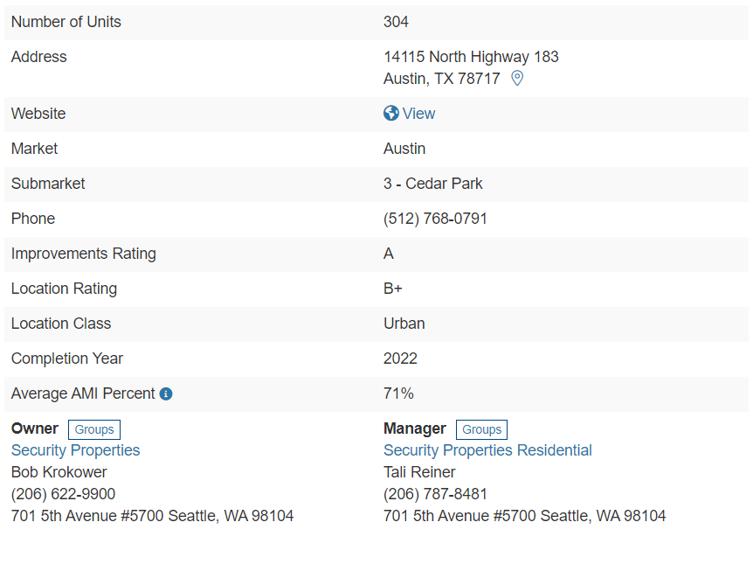
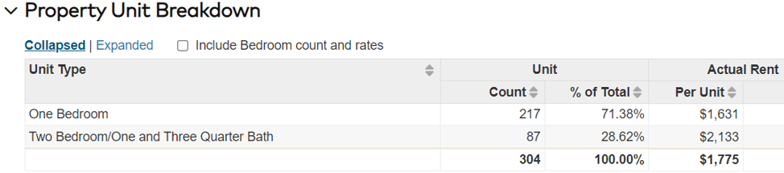
Average AMI (Area Median Income) Percent Metric
“Affordability” is defined as housing costs that consume 30% of gross household income
Actual rents are used to determine the AMI level where housing costs would be considered affordable
On average, the rents at this property are "affordable“ to households earning 71% of the county's Area Median Income (AMI)
Source: Yardi Matrix
Notes:
HUD tables:
https://www.huduser.gov/portal/datasets/home-datasets/files/HOME_IncomeLmts_State_AZ_2023.pdf
Use Windy Ridge Tx as an example actual 3/2 $1794/mo
Windy Ridge: https://matrix.pi-ei.com/PropertyDetail/All?MarketID=36&PropertyID=2467
“The AMI% metric takes the property average rent and calculates at what AMI Percentile would it be “affordable”. This is based on local County AMI tables produced annually by the US Dept of Housing and Urban Development (HUD). Based upon rent being equal to 30% of income, the government standard metric”

Slide 10
Austin’s Affordable Housing is Highly Competitive with Conventional Multifamily
The AMI percentile where rent equals 30% of income, the affordability standard
Average AMI Percent for each asset class minus the Average AMI Percent for Fully Affordable
Grouping Title | Average AMI Percent | Total Units | % Stock by Unit | AMI % Premium to Affordable | Competitive w/ Affordable
Discretionary (A+, A) | 78% | 64,765 | 23% | 20% | -
Upper Mid-Range (A-, B+) | 67% | 129,044 | 46% | 9% | 46%
Low Mid-Range (B, B-) | 54% | 56,338 | 20% | -3% | 20%
Workforce - Upper (C+, C) | 51% | 14,347 | 5% | -6% | 5%
Fully Affordable - Private Sector | 57% | 14,393 | 5% | - | -
Total/Average | 59% | 278,887 | 100% | - | ~71%
% of stock competitive with affordable housing
AMI % Premiums less than 10% are considered competitive with Affordable
“Total” row may not always sum due to rounding | Source: Yardi Matrix
Notes:
Jacob 8/13/24
Z:\MHN_Files\Matrix\Presentations & Webinars\Slide Deck\02 Multifamily\Affordable\CompetitiveAffordable
“The AMI% metric takes the property average rent and calculates at what AMI Percentile would it be “affordable”. This is based on local County AMI tables produced annually by the US Dept of Housing and Urban Development (HUD). Based upon rent being equal to 30% of income, the government standard metric”
“AMI is the area median income which is calculated on an annual basis by the U.S. Department of Housing and Urban Development (HUD) to determine affordability requirements.

Slide 11
In Some Markets, Affordable Housing is Highly Competitive with Conventional
AFFORDABLE HIGHLY COMPETITIVE
WITH CONVENTIONAL
AFFORDABLE MODERATELY COMPETITIVE WITH CONVENTIONAL
AFFORDABLE NOT COMPETITIVE
WITH CONVENTIONAL
Percentage of stock is by number of units. Competing units are defined as a <10% difference in AMI% Premiums between market-rate and fully affordable – private sector properties | Source: Yardi Matrix
Notes:
Jacob 8/13/24
Z:\MHN_Files\Matrix\Presentations & Webinars\Slide Deck\02 Multifamily\Affordable\CompetitiveAffordable

Slide 12
Austin’s Affordable Housing Occupancy is Below Conventional,
Since It’s Highly Competitive and Conventional Requires Less Compliance
 | Conventional | Affordable
Operating Income | $1,619 (-1.1% YoY) | $1,251 (+7.8% YoY)
Operating Expense | $848 (+0.3% YoY) | $630 (+10.2% YoY)
Turnover % | 50.4% (+0.1% YoY) | 36.0% (+12.9% YoY)
Data in table is an average for the 12-month period ending July 2024 | Source: Yardi Matrix Expert
Notes:
Z:\MHN_Files\Matrix\Presentations & Webinars\Slide Deck\02 Multifamily\Affordable\CompetitiveAffordable

Slide 13
Boston’s Affordable Housing Occupancy is Higher Than Conventional
Since There’s Not a Lot of Competitive Stock in the Market
 | Conventional | Affordable
Operating Income | $2,608 (+5.3%) | $2,183 (+7.7% YoY)
Operating Expense | $1,090 (+4.9%) | $1,106 (+5.8% YoY)
Turnover % | 36.0% (-2.1% YoY) | 9.6% (+7.0%)
Data in table is an average for the 12-month period ending July 2024 | Source: Yardi Matrix Expert
Notes:
Z:\MHN_Files\Matrix\Presentations & Webinars\Slide Deck\02 Multifamily\Affordable\CompetitiveAffordable

Slide 14

THANK YOU
Feel free to contact us with any questions
Paul Fiorilla| 908-256-1499 | Paul.Fiorilla@Yardi.com

Slide 15
APPENDIX

Slide 16
Market Inventory Affordability Report: Market Rate Units
AMI % Range | Average Rental Rate |  | AMI % | Total |  | % Stock
 | Per Unit | Per Sq Ft |  | Units | Sq Ft | Units | Sq Ft
0% - 29% | $580 | $0.94 | 26.1% | 12,355 | 7,488,953 | 0.1% | 0.1%
30% - 39% | $802 | $1.08 | 36.1% | 202,147 | 150,037,919 | 1.5% | 1.2%
40% - 49% | $1,004 | $1.27 | 45.3% | 1,048,389 | 827,674,487 | 7.6% | 6.7%
50% - 59% | $1,236 | $1.48 | 54.6% | 2,193,528 | 1,836,528,669 | 15.8% | 14.8%
60% - 69% | $1,505 | $1.70 | 64.5% | 2,593,578 | 2,297,659,229 | 18.7% | 18.5%
70% - 79% | $1,758 | $1.90 | 74.3% | 2,487,249 | 2,297,111,237 | 17.9% | 18.5%
80% - 89% | $2,011 | $2.12 | 84.1% | 1,858,420 | 1,763,719,211 | 13.4% | 14.2%
90% - 99% | $2,281 | $2.36 | 94.0% | 1,087,735 | 1,049,449,229 | 7.8% | 8.4%
100% - 109% | $2,548 | $2.59 | 104.0% | 605,447 | 593,891,012 | 4.4% | 4.8%
110% - 119% | $2,782 | $2.82 | 113.6% | 314,560 | 308,930,540 | 2.3% | 2.5%
120% - 129% | $3,066 | $3.11 | 124.1% | 191,922 | 188,003,564 | 1.4% | 1.5%
130% - 139% | $3,369 | $3.50 | 134.3% | 112,006 | 107,138,492 | 0.8% | 0.9%
> 140% | $4,451 | $4.63 | 169.3% | 238,519 | 227,347,398 | 1.7% | 1.8%
Total |  |  |  | 12,945,855 | 11,654,979,940 | 93.4% | 93.9%
Averages | $2,107 | $2.27 | 86.5%
Affordable units within partially affordable properties are not included. Data as of August 2024 | Source: Yardi Matrix
Notes:
Jacob 9/9/24
Portal

Slide 17
Market Inventory Affordability Report: Fully Affordable Units
AMI % Range | Average Rental Rate |  | AMI % | Total |  | % Stock
 | Per Unit | Per Sq Ft |  | Units | Sq Ft | Units | Sq Ft
0% - 29% | - | - | 7.0% | 216 | 165,681 | 0.0% | 0.0%
30% - 39% | $857 | $1.09 | 36.5% | 5,355 | 3,617,486 | 0.0% | 0.0%
40% - 49% | $1,065 | $1.51 | 46.1% | 58,228 | 45,436,846 | 0.4% | 0.4%
50% - 59% | $1,145 | $1.37 | 55.1% | 385,848 | 325,081,646 | 2.8% | 2.6%
60% - 69% | $1,329 | $1.55 | 60.0% | 465,010 | 400,975,622 | 3.4% | 3.2%
70% - 79% | - | - | 72.8% | 542 | 427,712 | 0.0% | 0.0%
80% - 89% | $1,606 | $2.11 | 80.0% | 470 | 357,888 | 0.0% | 0.0%
Total |  |  |  | 915,669 | 776,062,881 | 6.6% | 6.2%
Averages | $1,200 | $1.53 | 51.1%
Affordable units within partially affordable properties are not included. Data as of August 2024 | Source: Yardi Matrix
Notes:
Jacob 9/9/24
Portal

Slide 18
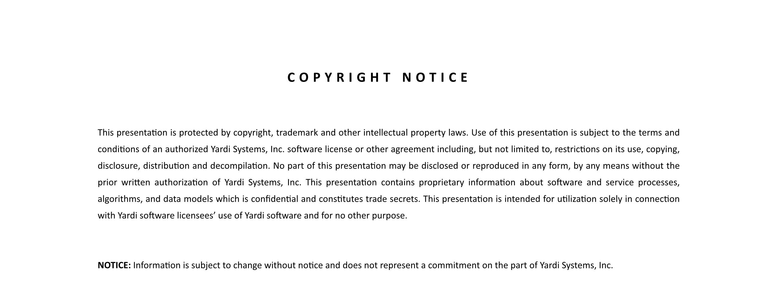

©2024 Yardi Systems, Inc. All Rights Reserved. Yardi, the Yardi logo, and all Yardi product names are trademarks of Yardi Systems, Inc. All other products mentioned herein may be trademarks of their respective companies.
Notes:
Please note this slide NOT editable.
Please notify the corporate design team of any necessary updates to this slide.

