Slide 1

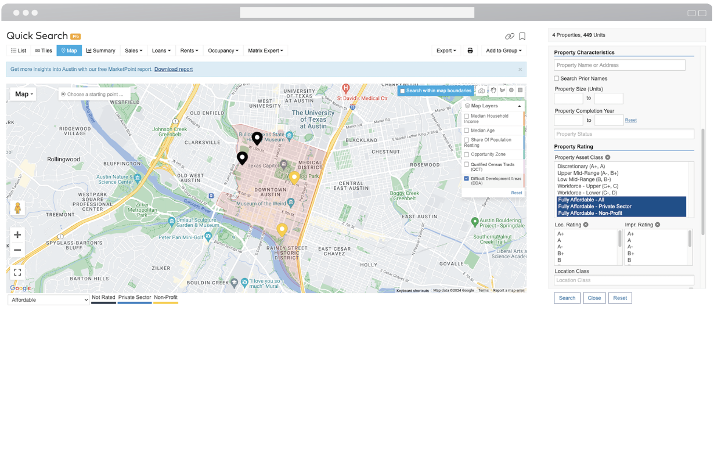
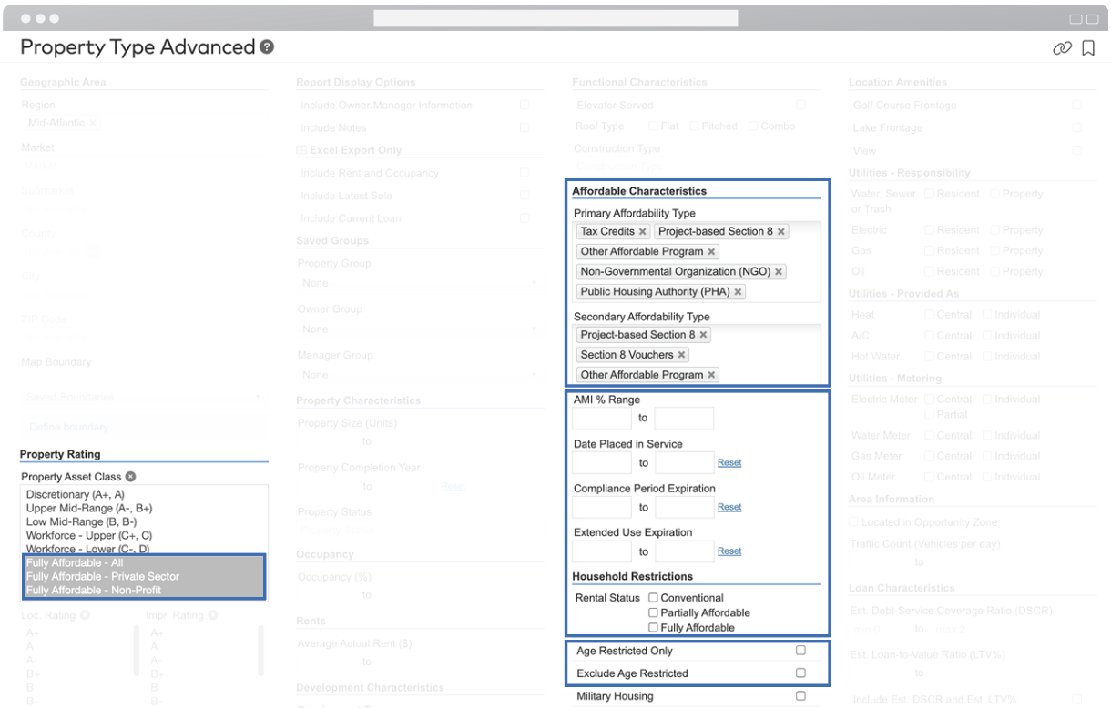
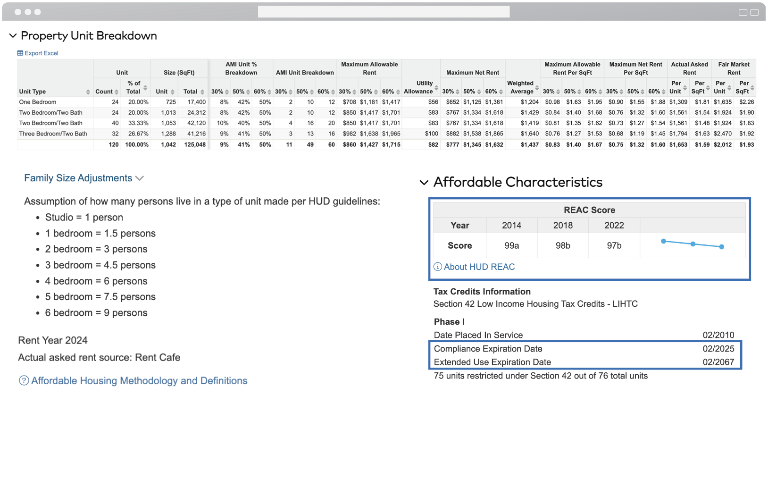


INTRODUCING AFFORDABLE HOUSING
Accessing essential data for fully affordable multifamily investments has never been easier
Search by characteristics
QCT & DDA
map overlays
Detailed AMI% splits, REAC scores & more
Notes:
Show screen shot of paying rent, maintenance, etc.

Slide 2
INTRODUCING AFFORDABLE HOUSING
Accessing essential data for fully affordable multifamily investments has never been easier.
Detailed AMI% splits, REAC scores & more
QCT & DDA
map overlays
Search by characteristics
Notes:
Show screen shot of paying rent, maintenance, etc.

