Slide 1
Apartment Market Forecast for Sacramento Region
Doug Ressler
Director of Business Intelligence, Yardi-Matrix
September 28, 2017

Slide 2
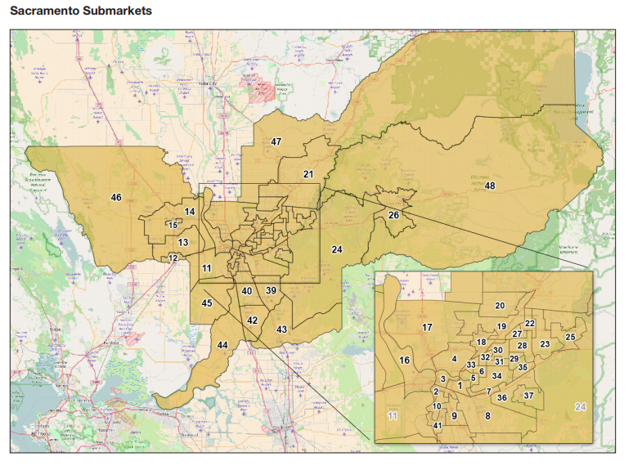
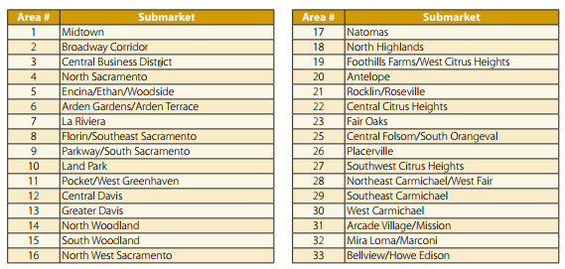
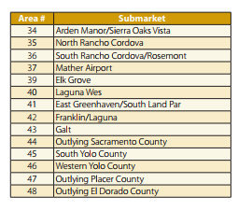
Sacramento Market & Sub Markets
Source: Yardi® Matrix

Slide 3
Existing Residential Inventory

Slide 4
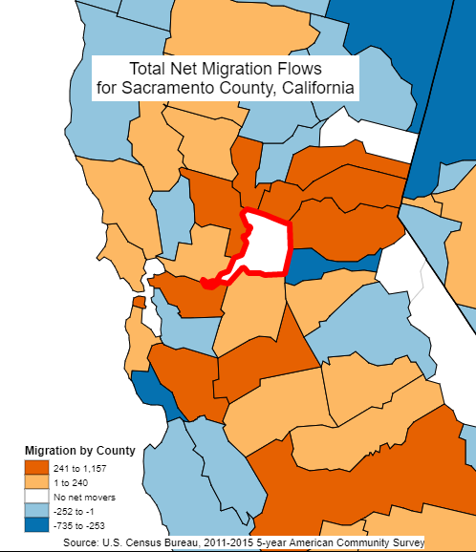
Metro Overview – Sacramento Population
Source: California Department of Transportation; U.S. Census Bureau (BOC)

Slide 5
Net Migration Flows
Source: Yardi® Matrix, U.S. Census Bureau (BOC)

Slide 6
Rent and Income Growth has Diverged Since 2012
Harvard Joint Center for Housing Studies has done great work on the bigger impact on low income Americans
Source: Yardi® Matrix, Moody’s Analytics

Slide 7
Sacramento Median Rent vs. Median Income
Source: Yardi® Matrix, U.S. Census Bureau (BOC)

Slide 8
Owner and Renter Households by Age Cohort
Source: U.S. Census Bureau (BOC)

Slide 9
All Rental Households by Income
Source: U.S. Census Bureau (BOC)

Slide 10
Owner and Renter Housing Stock by Tenure & Type
Source: U.S. Census Bureau (BOC)

Slide 11
5+ Unit Rental Stock by Year Built
Source: Yardi® Matrix

Slide 12
Forecast – New Housing Permits
Source: U.S. Department of Housing and Urban Development

Slide 13
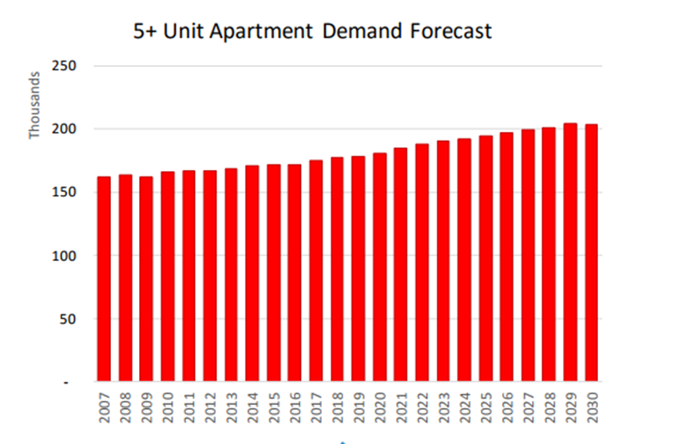
HUD 5+ Unit Demand Sacramento Forecast
Source: U.S. Housing and Urban Development

Slide 14
Employment Growth By Sector (thou.)
Source: Moody’s Analytics

Slide 15
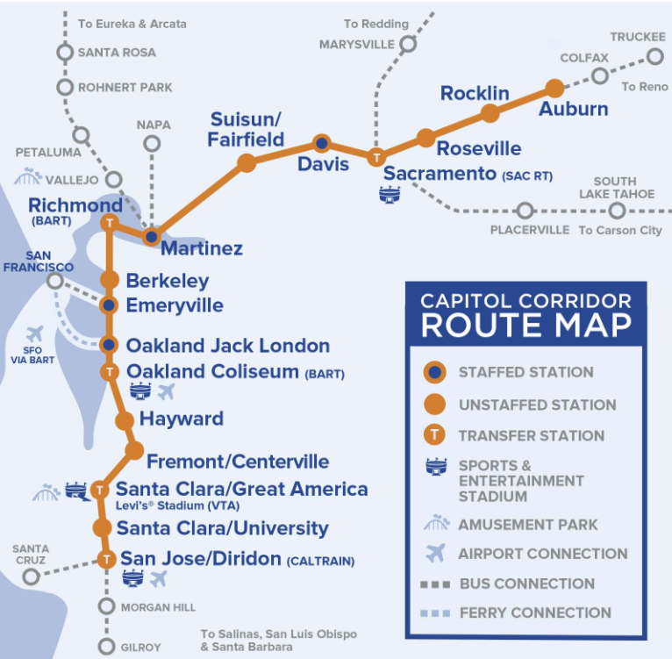
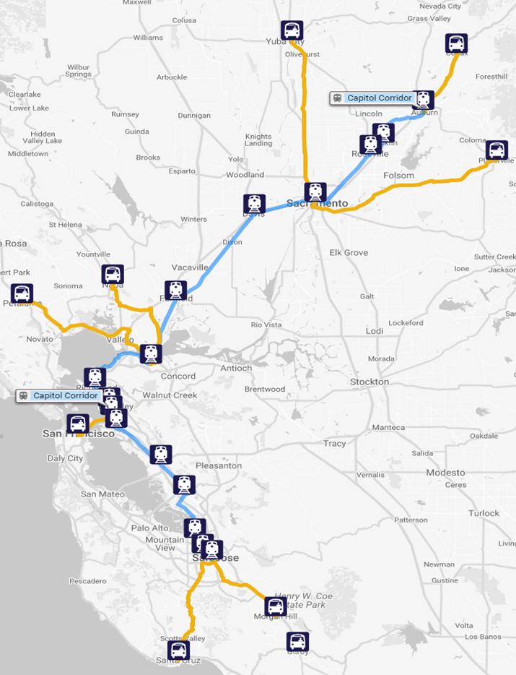
Transportation
Source: Capital Corridor Route Map

Slide 16
Transportation

Slide 17
Copyright & Disclaimer
This document, presentation and/or video (collectively, “document”) is protected by copyright, trademark and other intellectual property laws. Use of this document is subject to the terms and conditions of an authorized Yardi Systems, Inc. software license or other agreement including, but not limited to, restrictions on its use, copying, disclosure, distribution and decompilation. No part of this document may be disclosed or reproduced in any form by any means without the prior written authorization of Yardi Systems, Inc. This document contains proprietary information about software and service processes, algorithms, and data models which is confidential and constitutes trade secrets. This document is intended for utilization solely in connection with Yardi software licensees’ use of Yardi software and for no other purpose.
Yardi®, Yardi® Matrix, Yardi Systems, Inc., the Yardi Logo, and the names of Yardi products and services are trademarks or registered trademarks of Yardi Systems, Inc. in the United States and may be protected as trademarks in other countries. All other product, service, or company names mentioned in this document are claimed as trademarks and trade names by their respective companies.
© 2017 Yardi Systems, Inc. All Rights Reserved.

Slide 18
Contact
  Doug Ressler, Director of Business Intelligence Yardi Matrix
    Doug.Ressler@Yardi.com, 1-800-866-1124 x 2419
    A Copy of the Today’s Presentation is available at: www.yardimatrix.com

